Slide 1
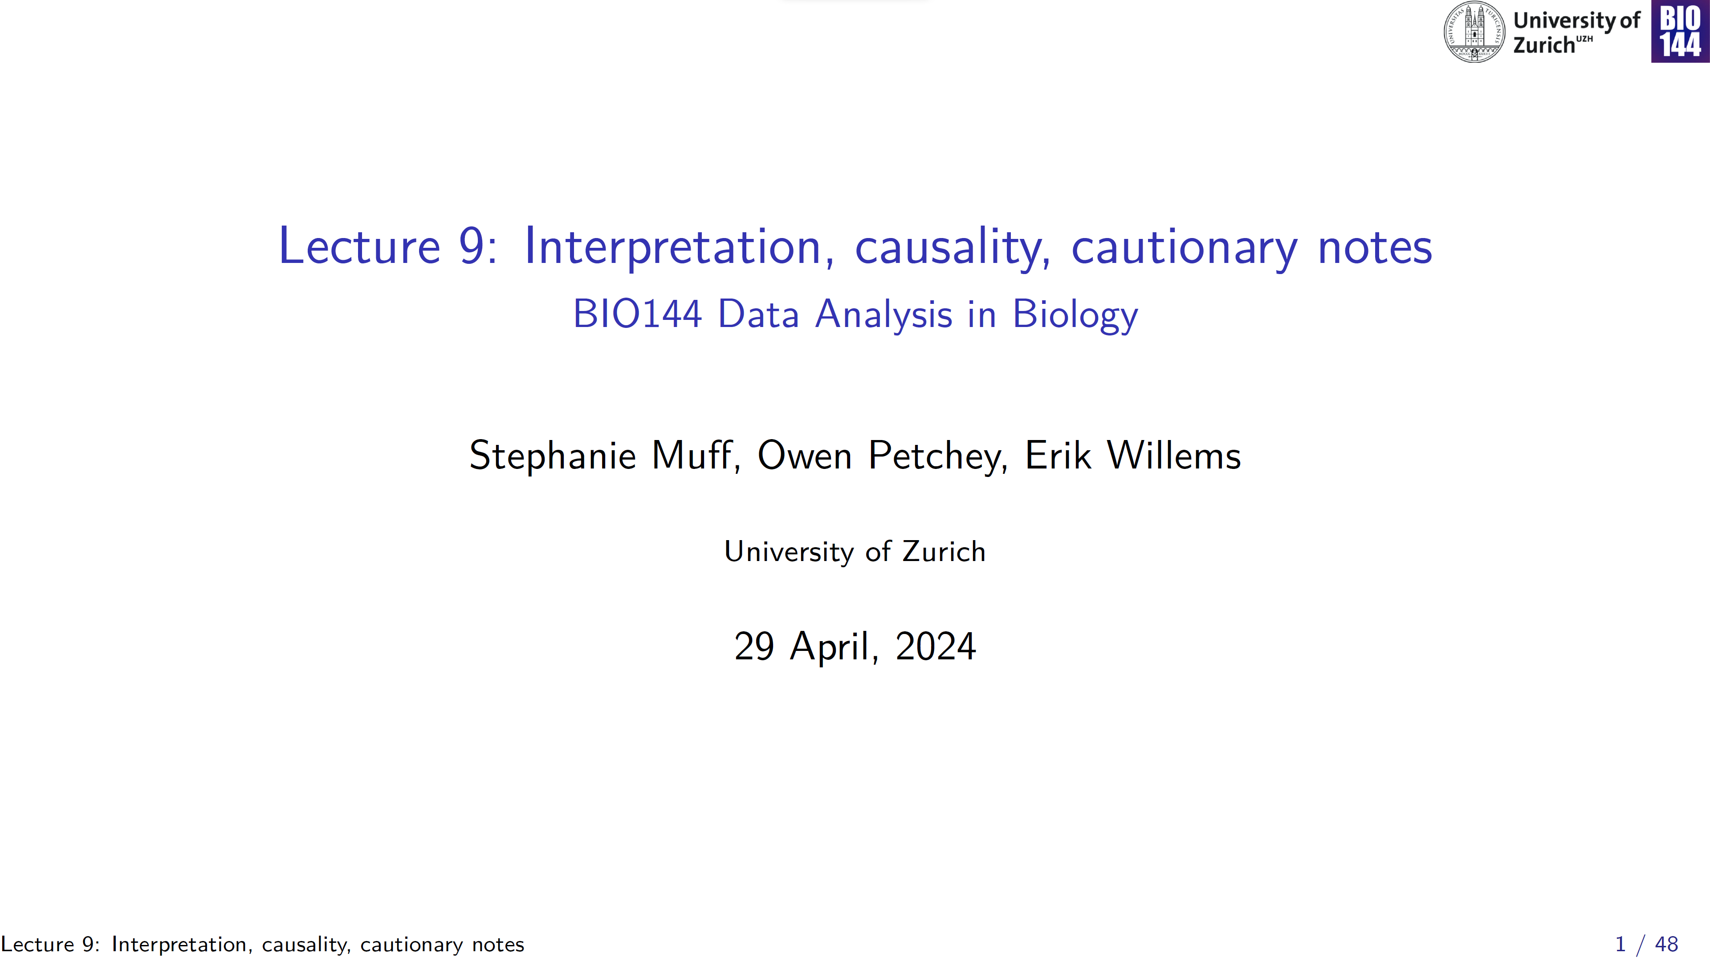

Slide 2
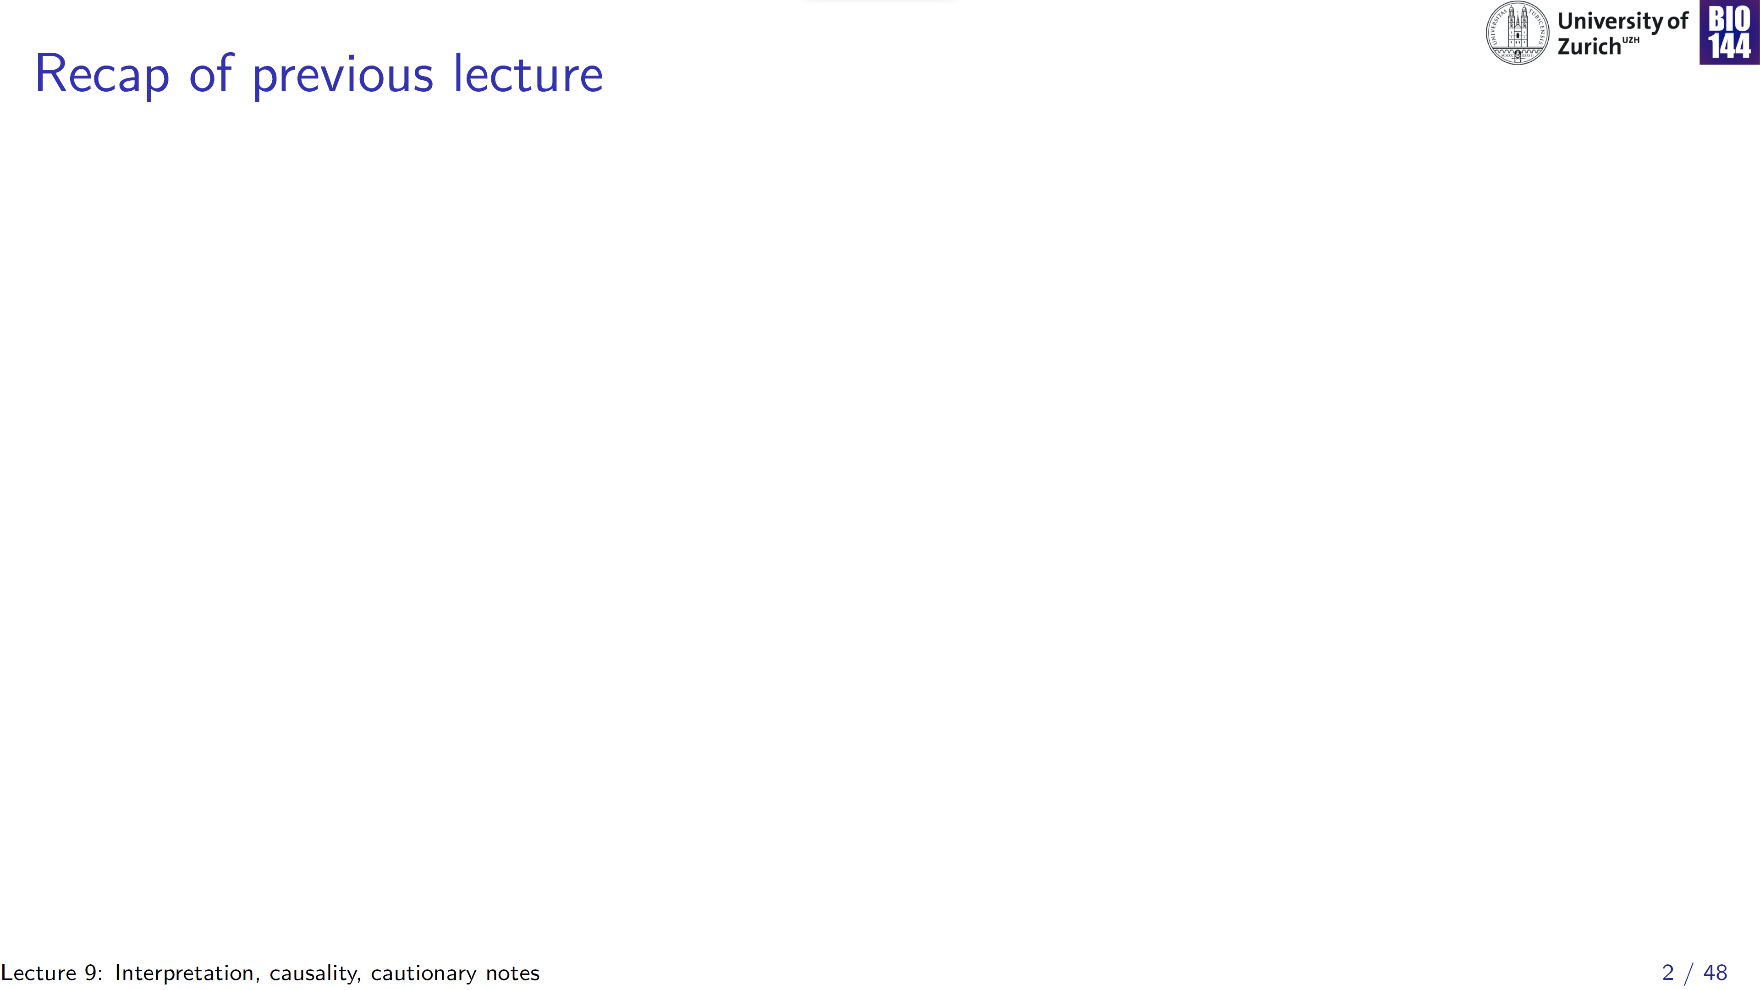
Predictive
→ Predict future values of y
Can use automated model selection (AIC, AICc, BIC)
Collinearity not really an issue
Statistical model
Confirmatory
→ Test hypotheses
Explanatory
Exploratory
→ Generate hypotheses
Don’t use automated model selection
Collinearity a potential issue
Notes:
We ended last week’s lecture with looking at some strategies to fit explanatory models

Slide 3
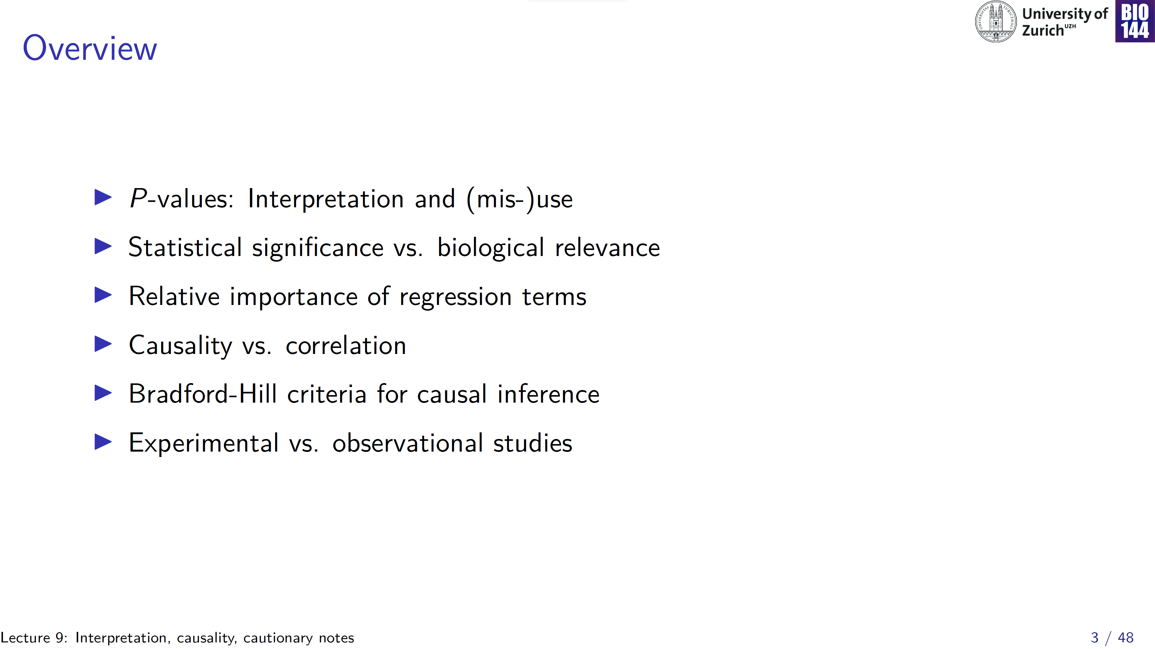

Slide 4
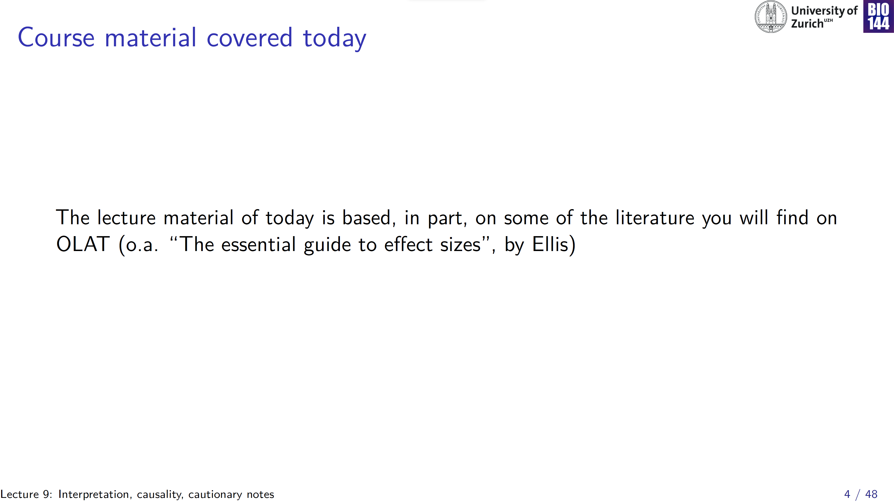
Notes:
Link on OLAT, under Homework

Slide 5
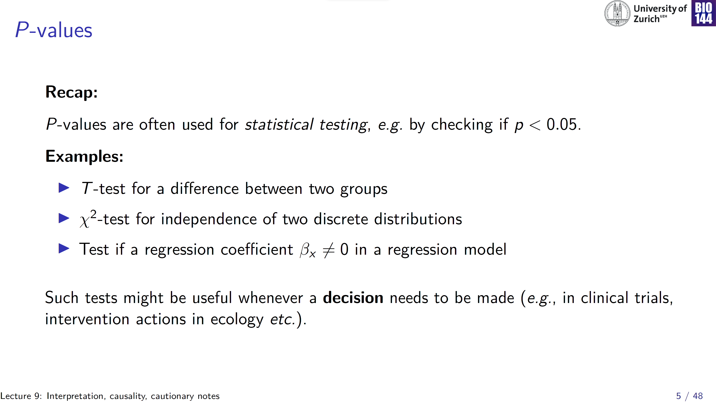

Slide 6
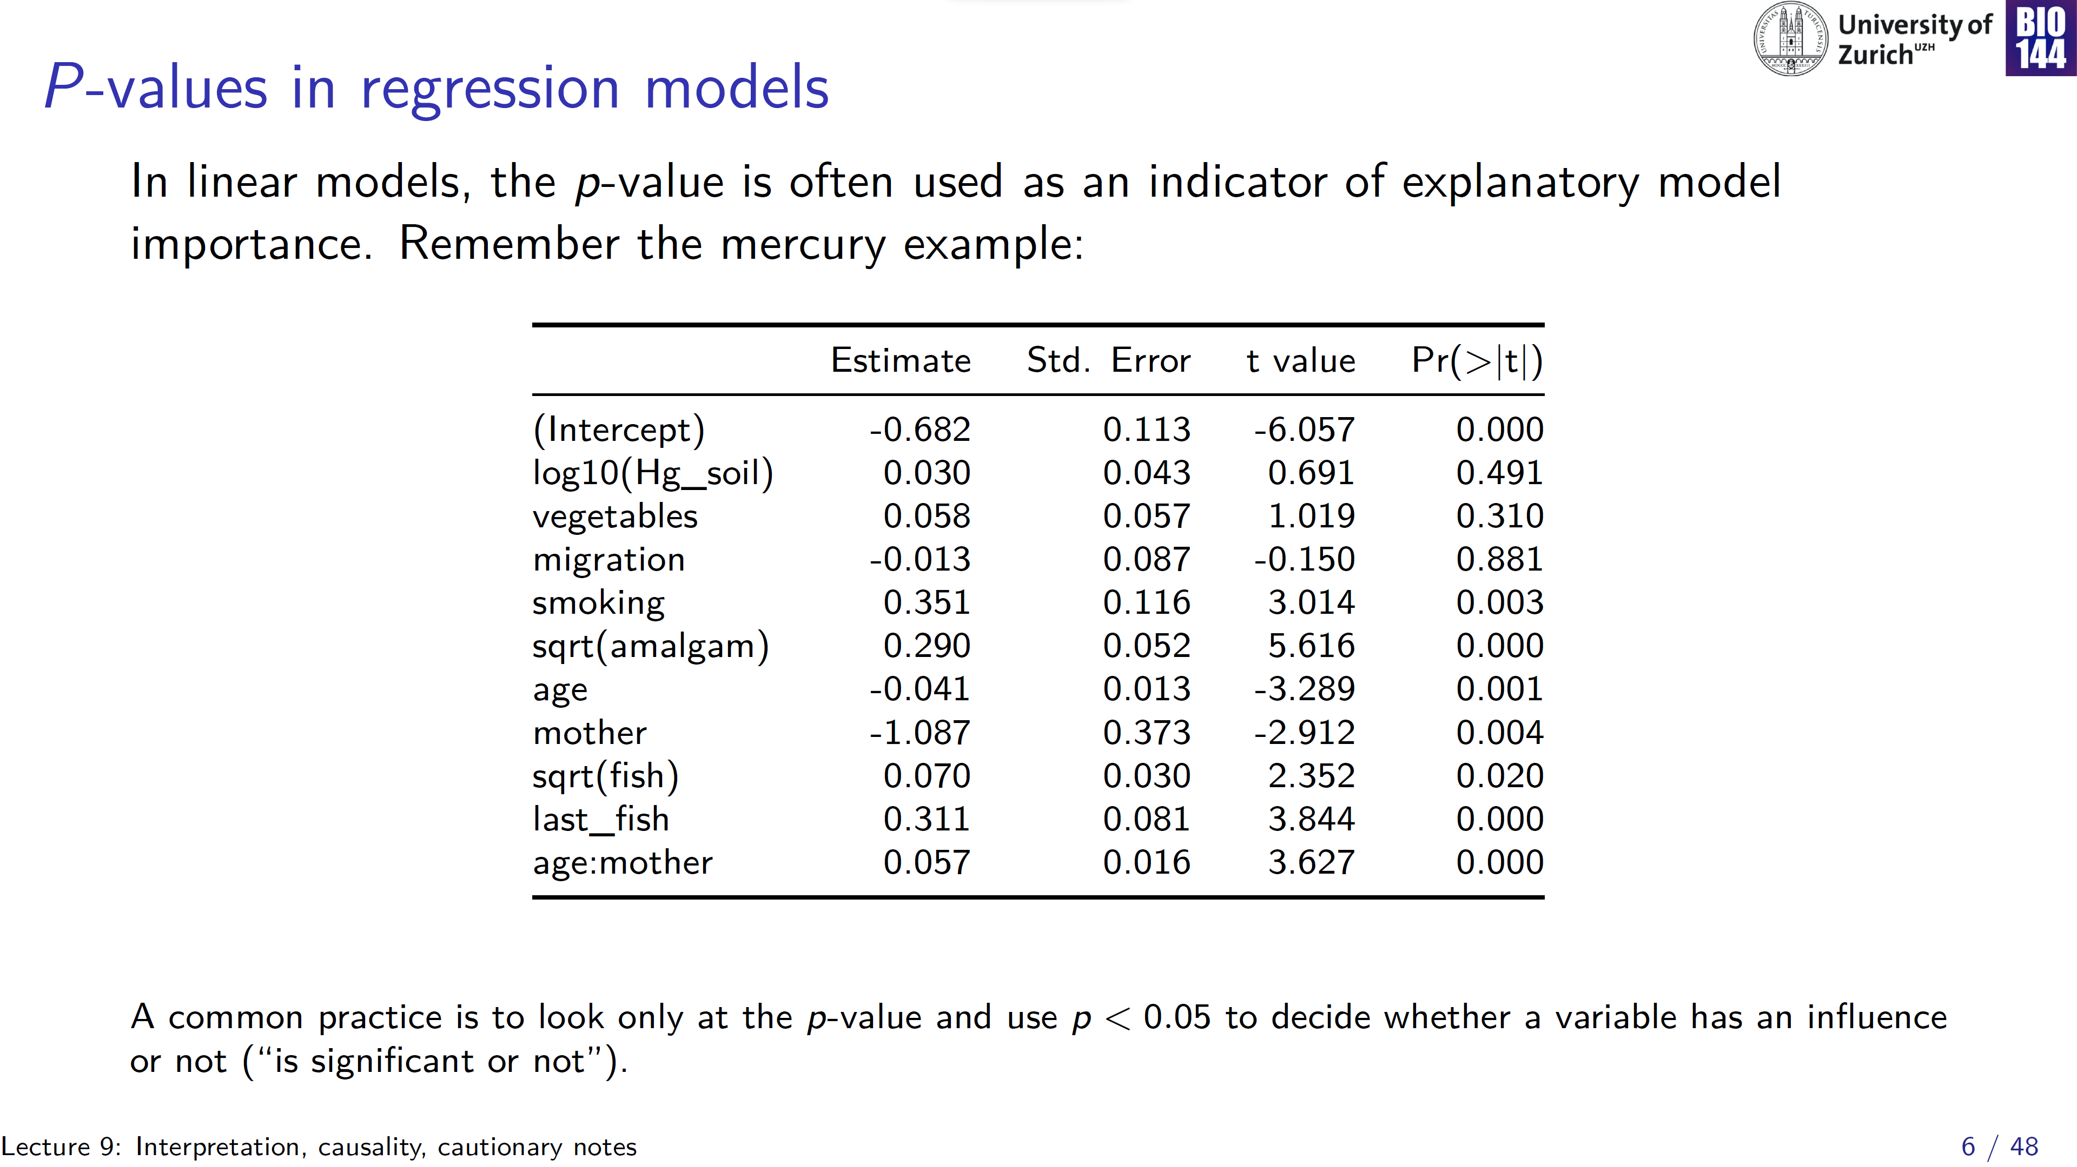
Value of y, when all x = 0
Interpret “bottom-up”
Notes:
This caused a lot of confusion, changed red lines to only cross out the t and p-values!

Slide 7
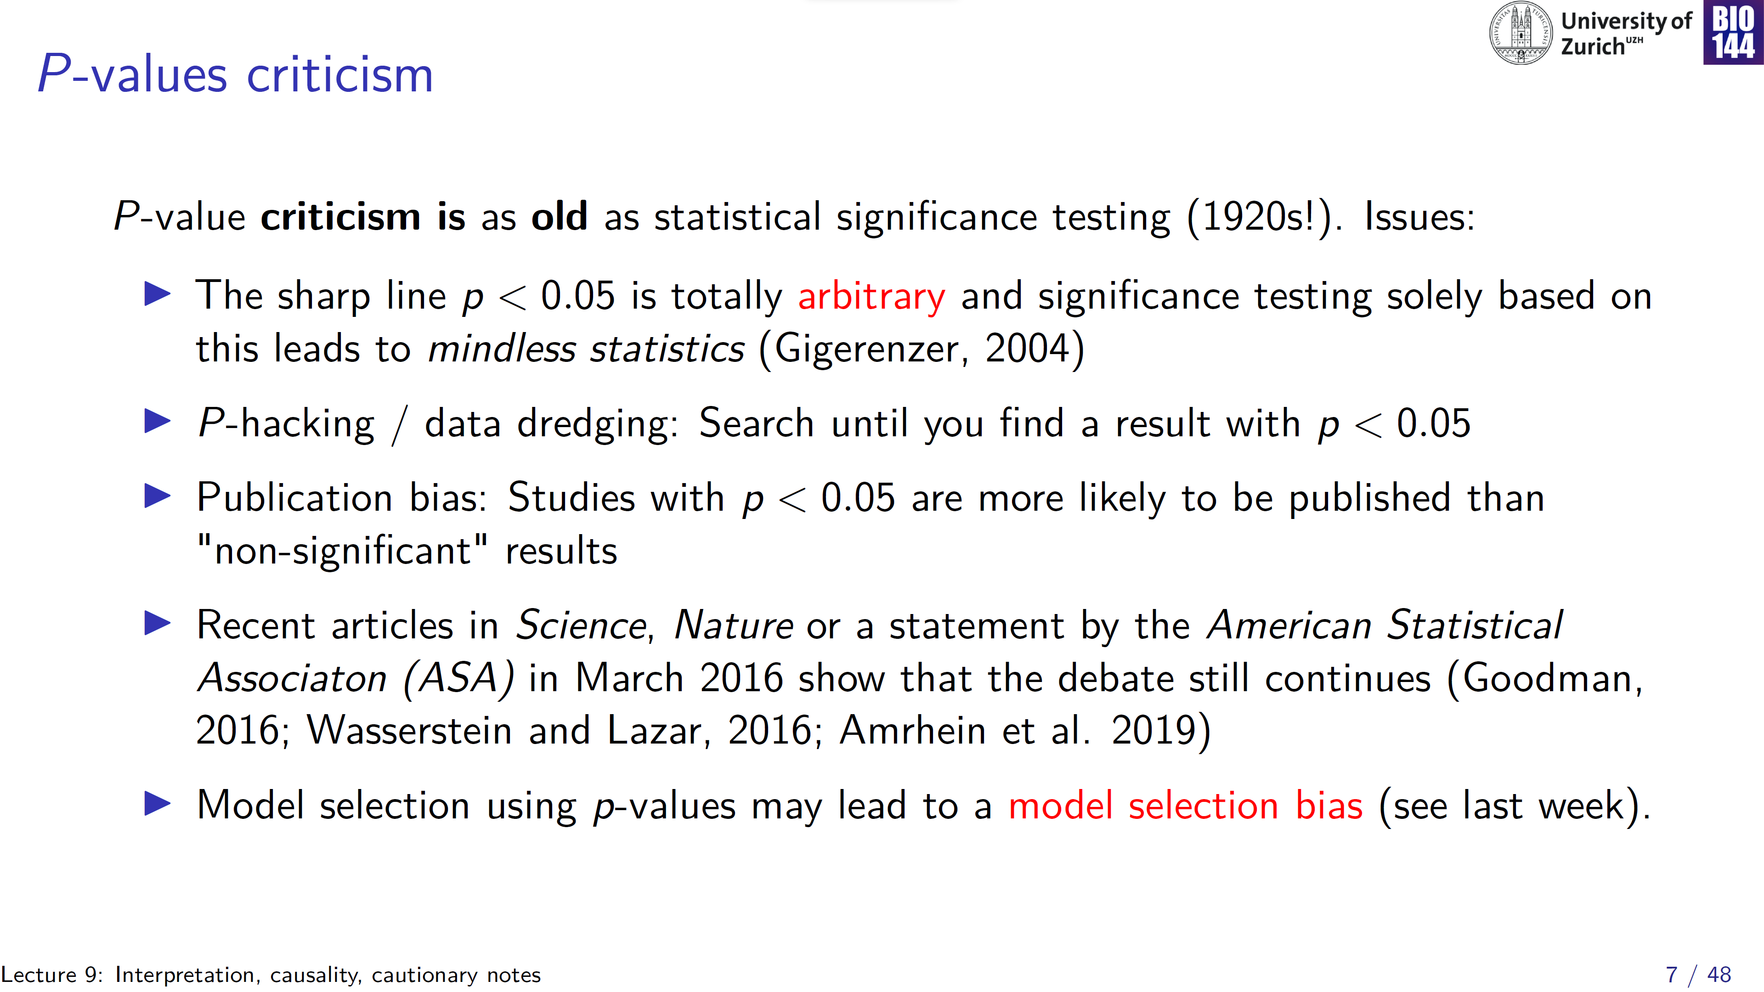

Slide 8
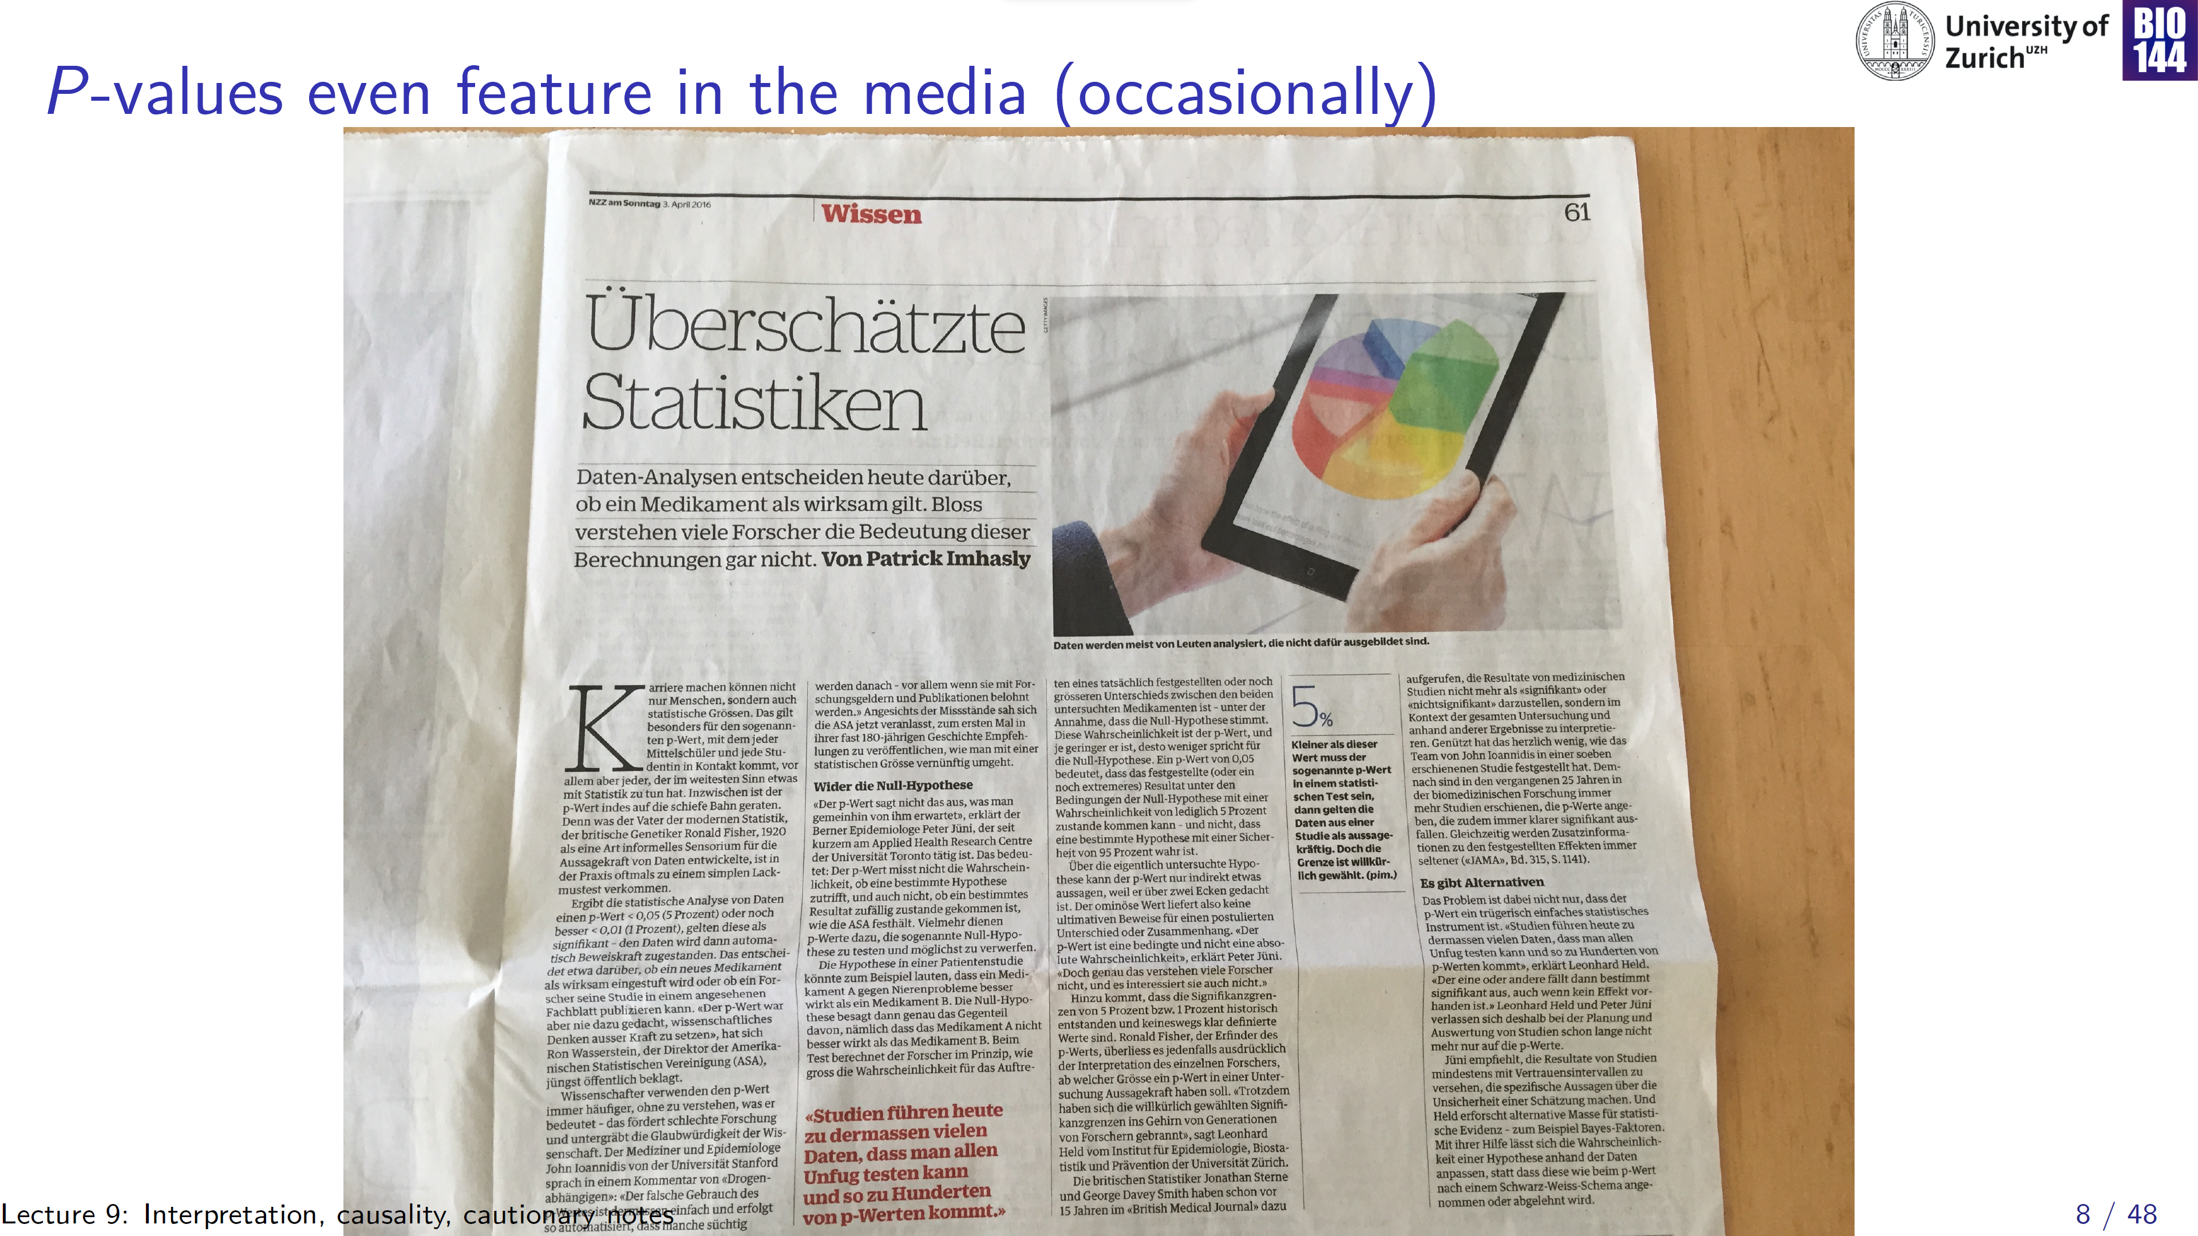

Slide 9
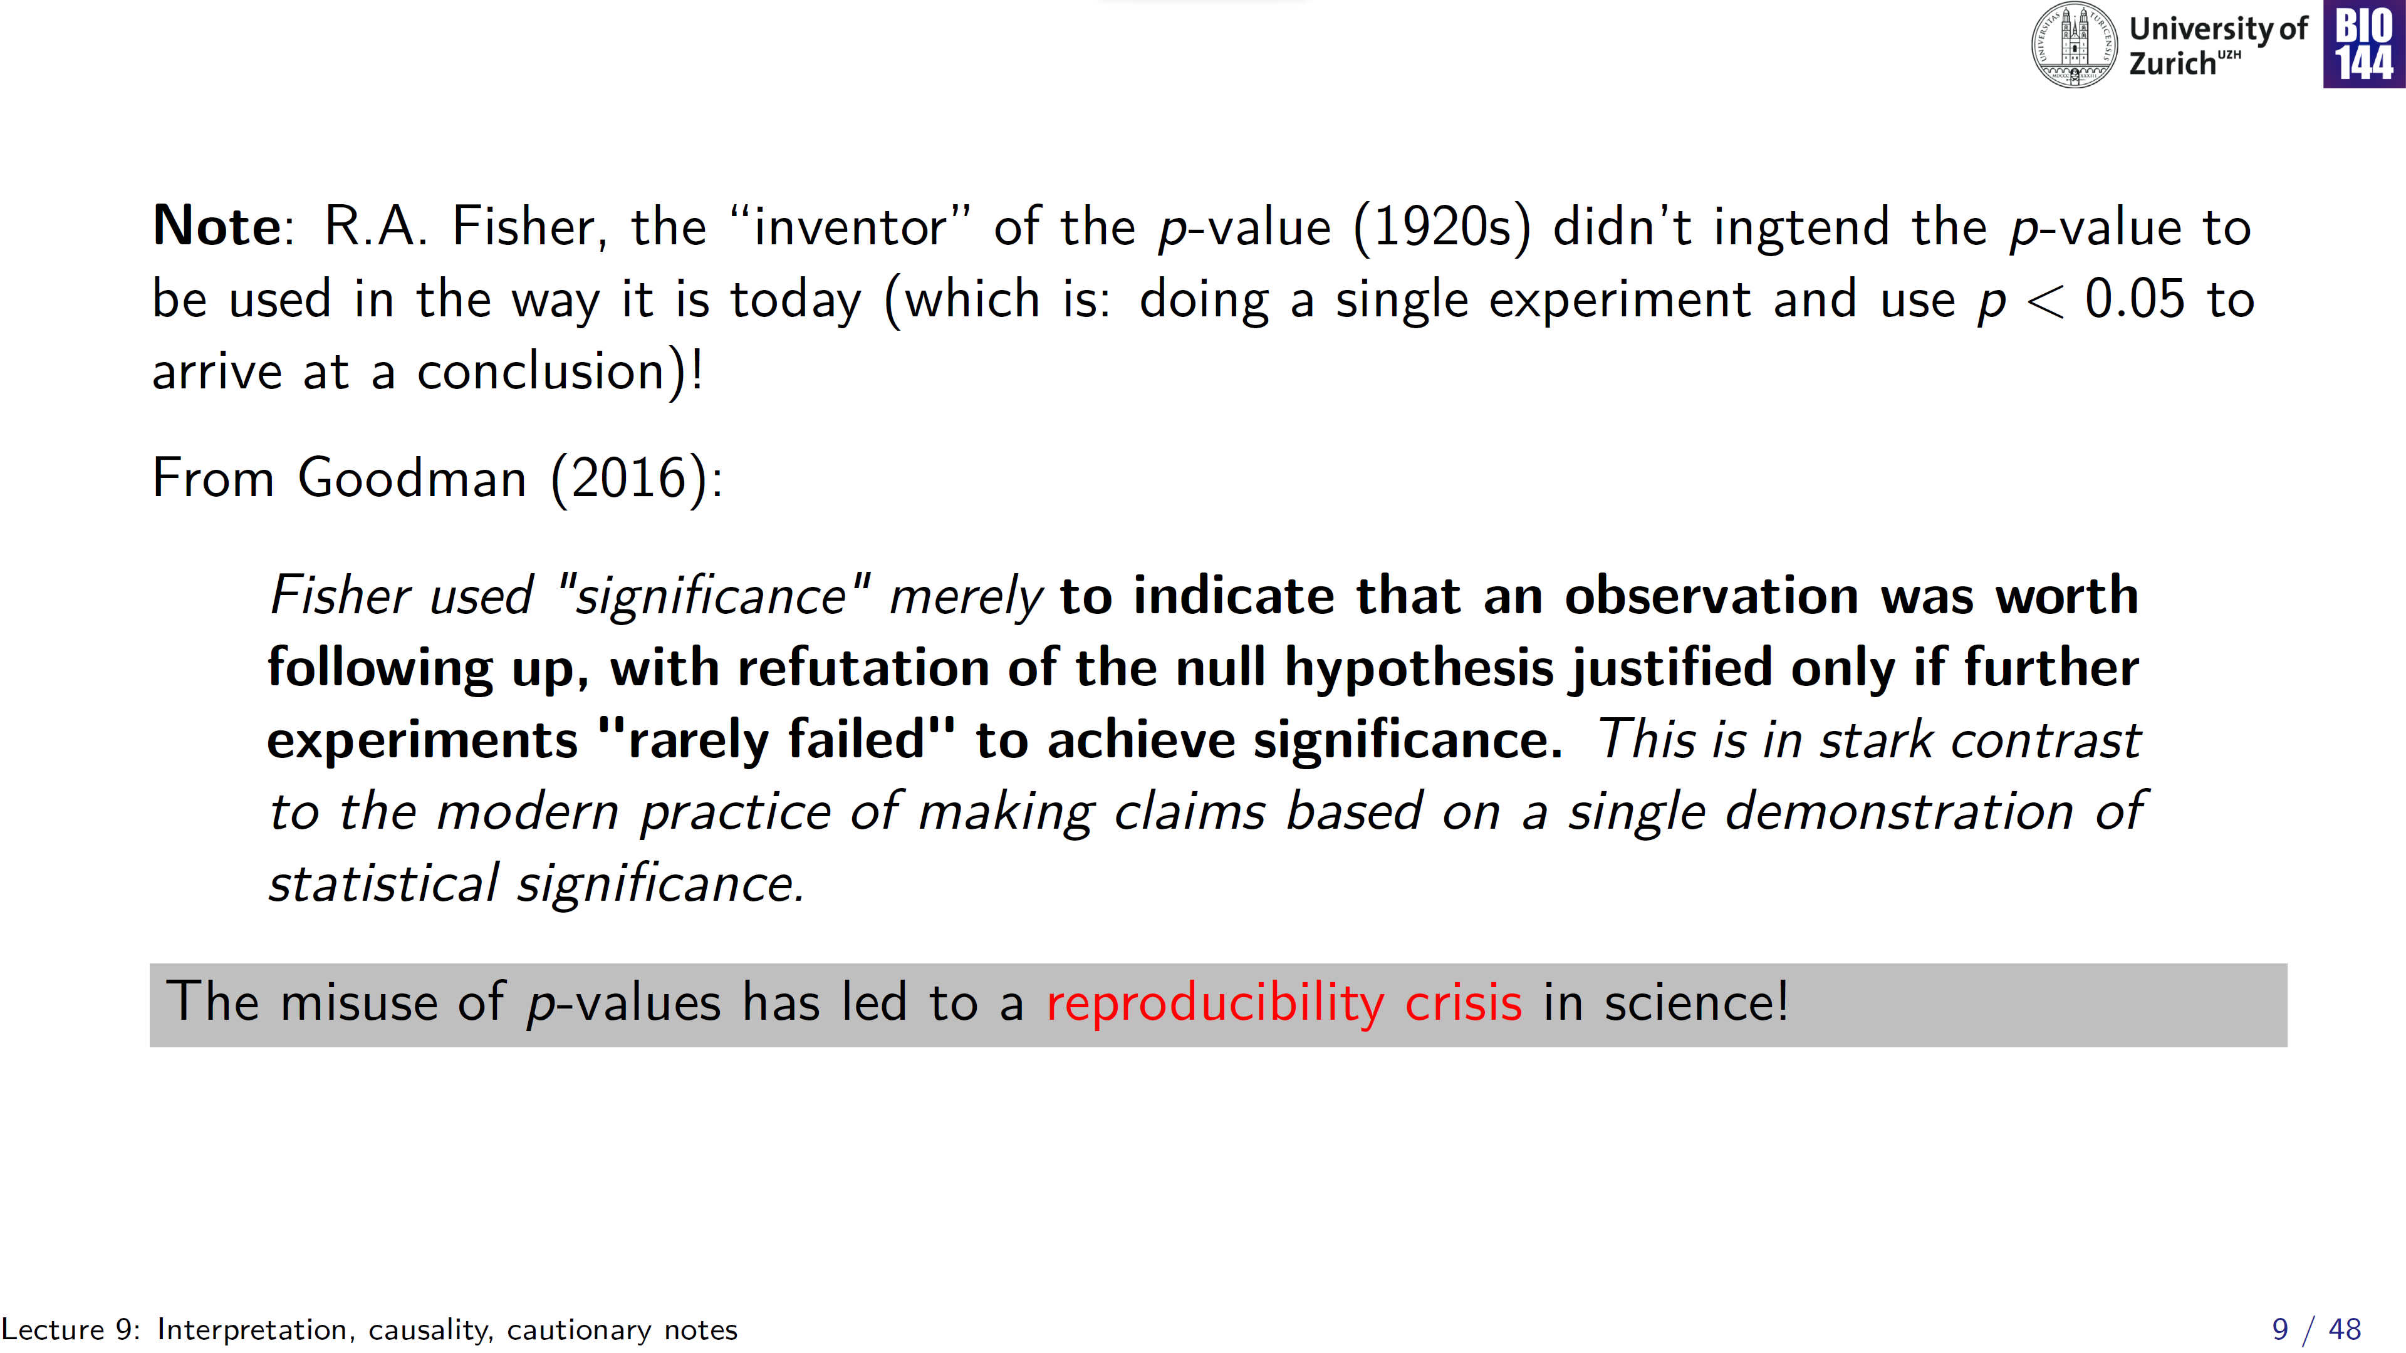
Notes:
Not the sole reason for the reproducibility crises, but most certainly an important contributing factor!

Slide 10
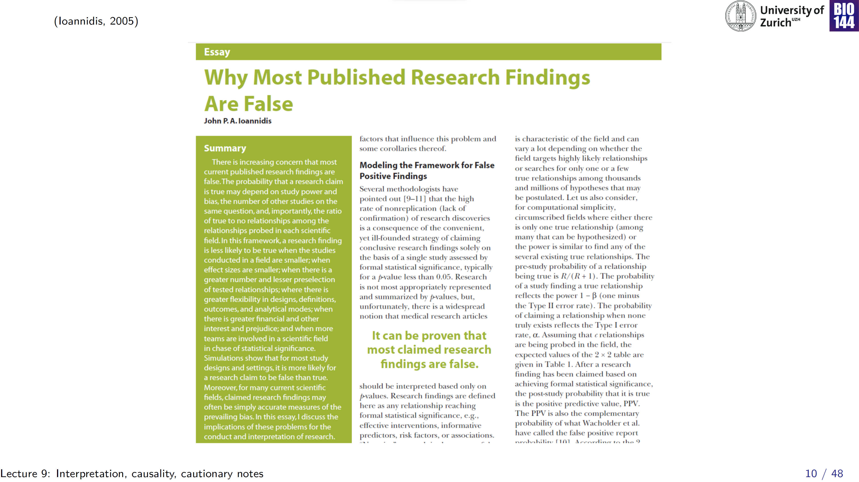
Notes:
Rather sobering, but also full of pointers to improve!

Slide 11
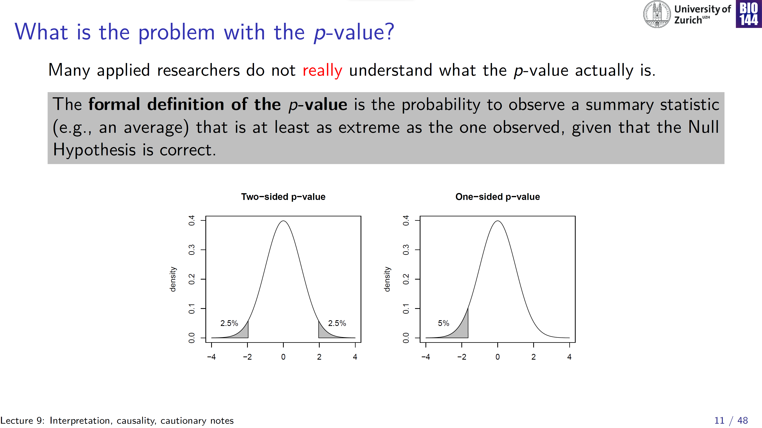
Non-directional hypothesis
Directional hypothesis
Notes:
Non-directional hypothesis vs. directional hypothesis. In biology, more so than medicine, strict use of two-tailed tests to keep tigter control over Type I error

Slide 12
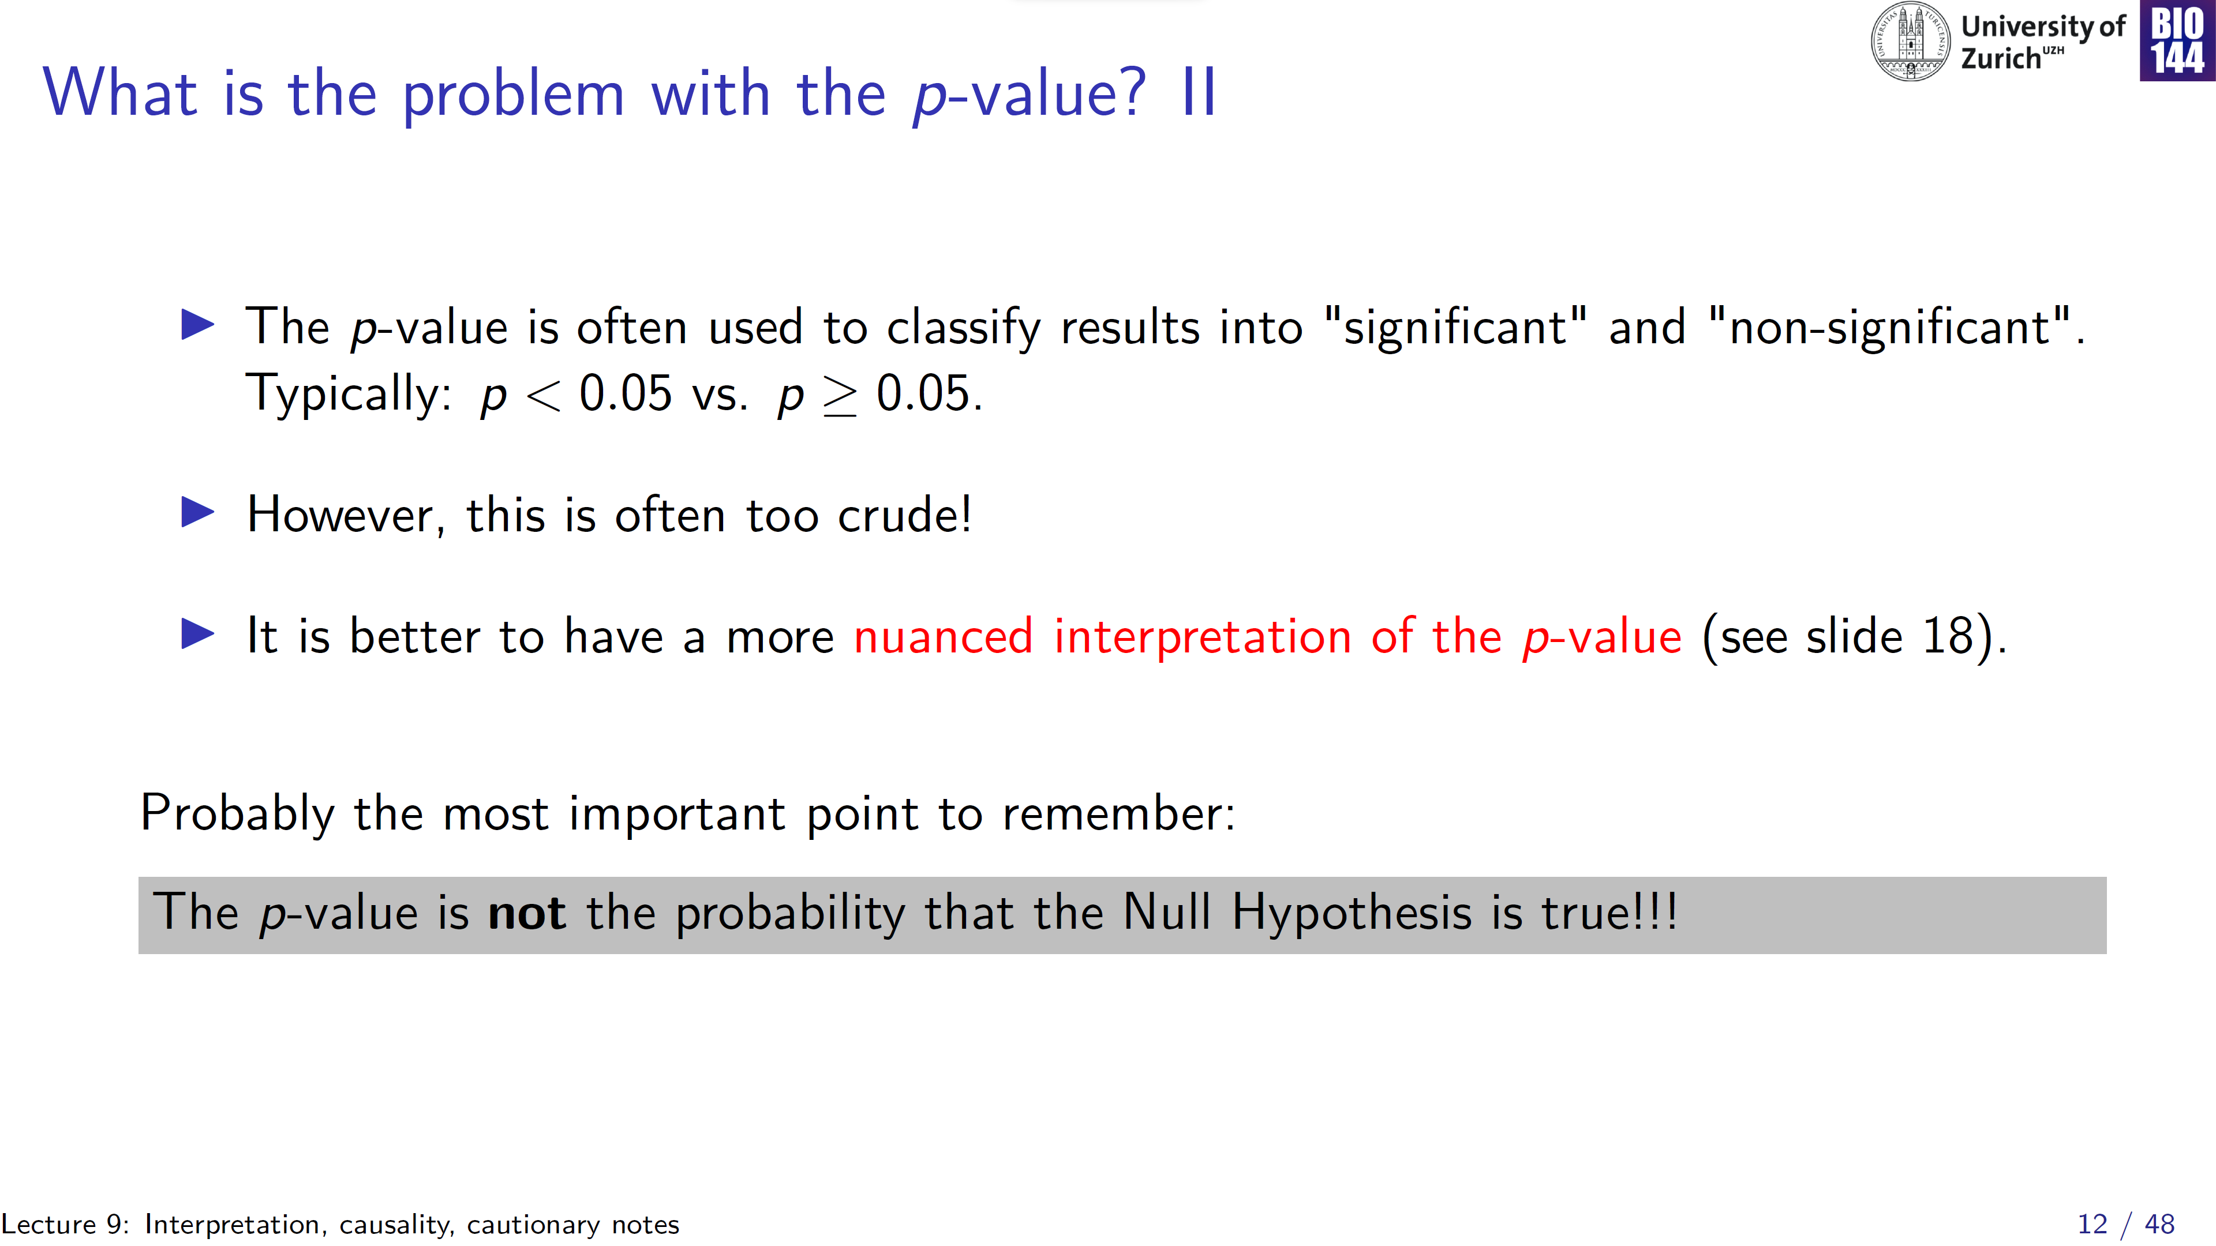
Science progresses through falsification

Slide 13
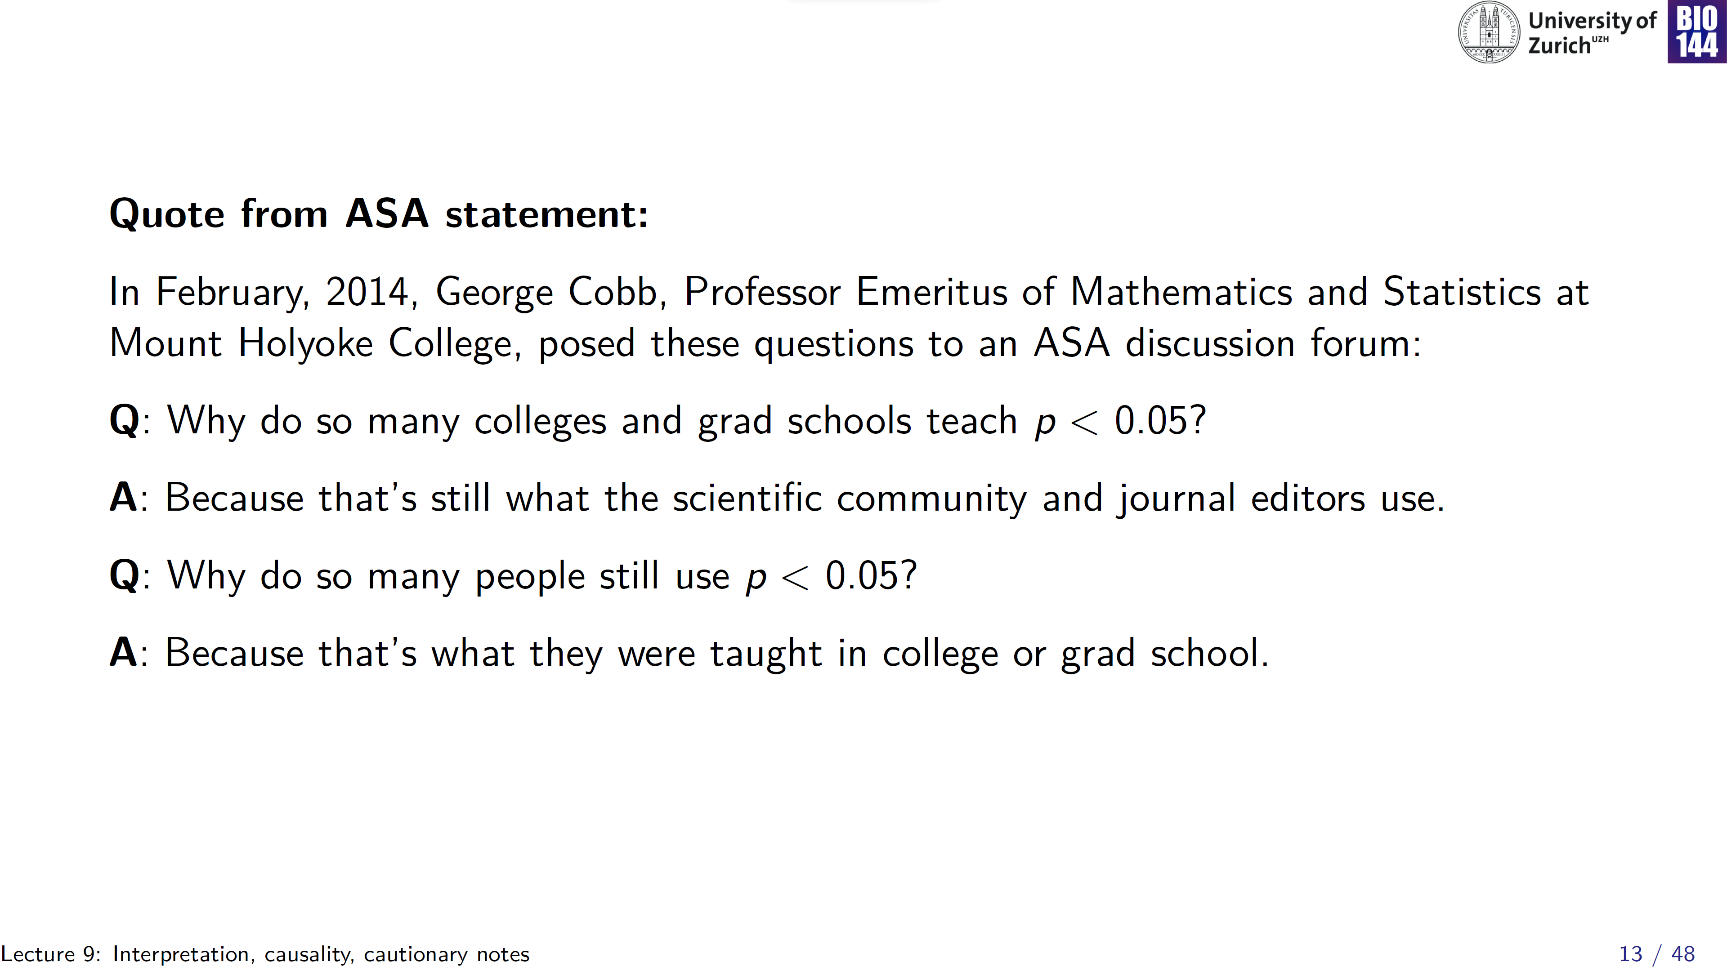
We’re stuck in the status quo!
Notes:
We seem to have gotten stuck in the status quo!

Slide 14
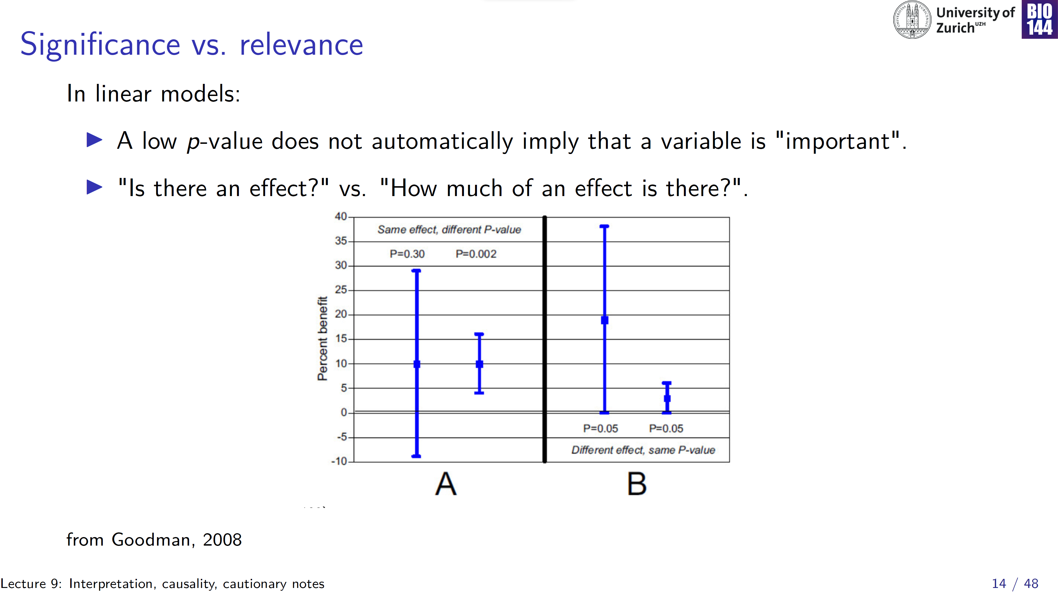
Notes:
The mean could e.g. be the beta in a linear model, the error bars reflect the SE from the summary table.
Right panel: not very certain, but there could be a large effect vs. quite certain that there is a small effect

Slide 15
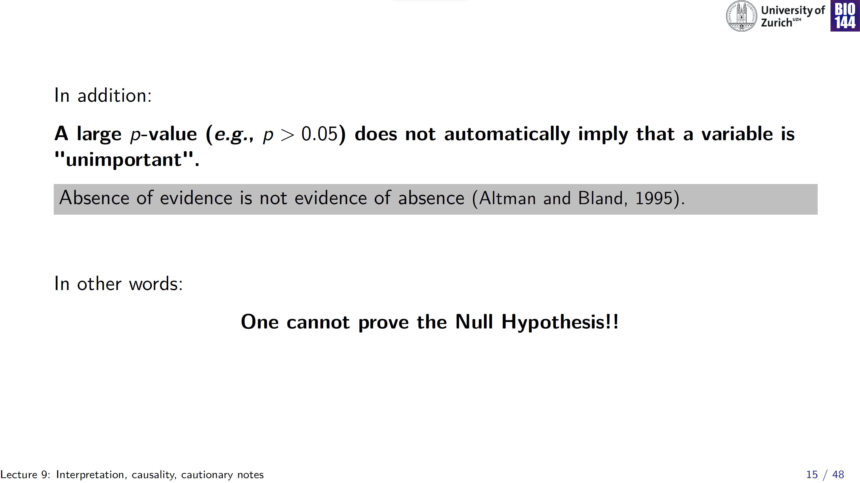
Again:
science progresses through falsification

Slide 16
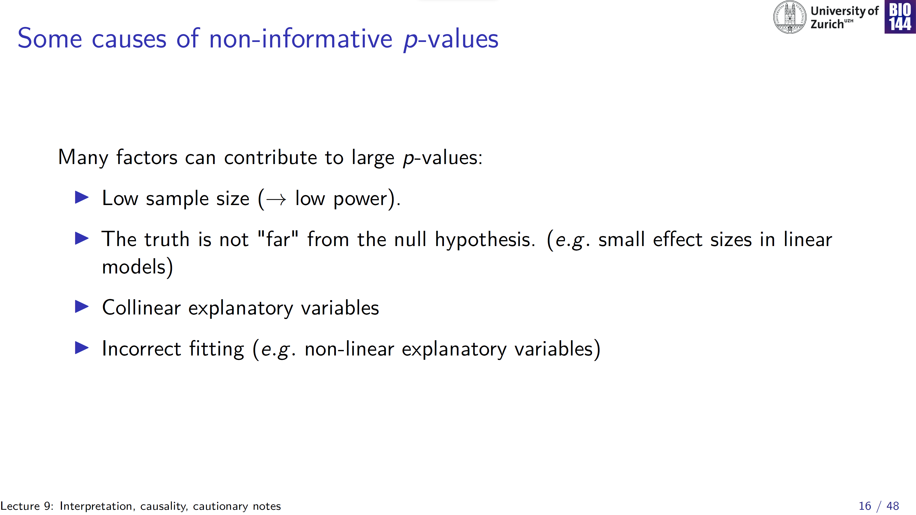
y
x
Notes:
Small sample size

Slide 17
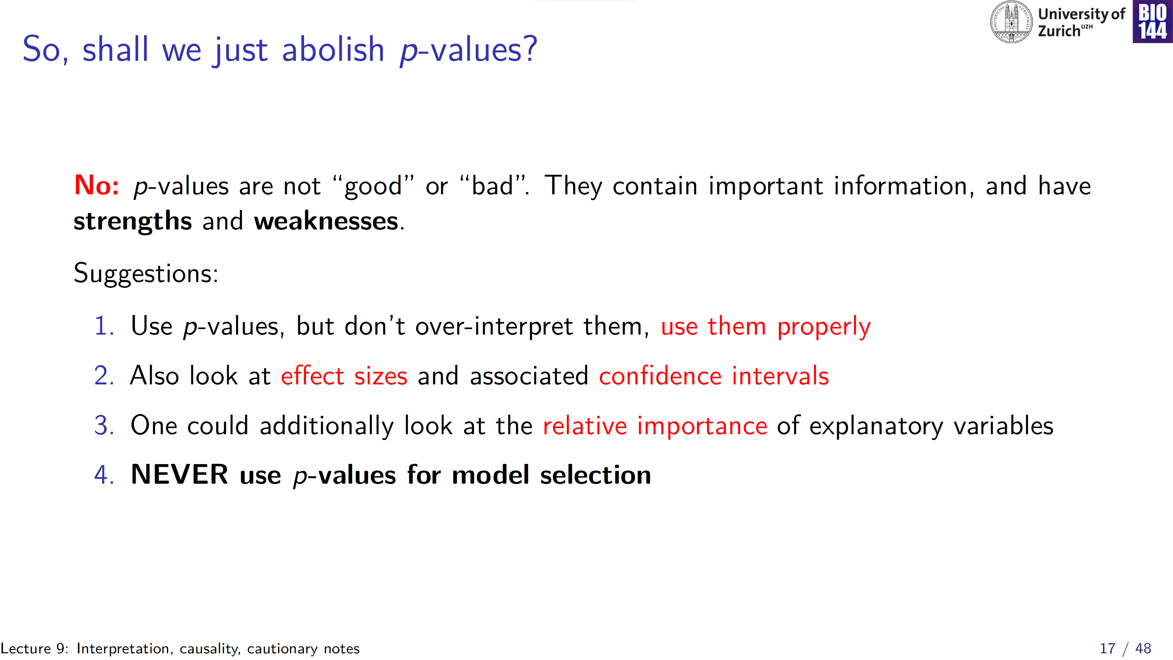

Slide 18
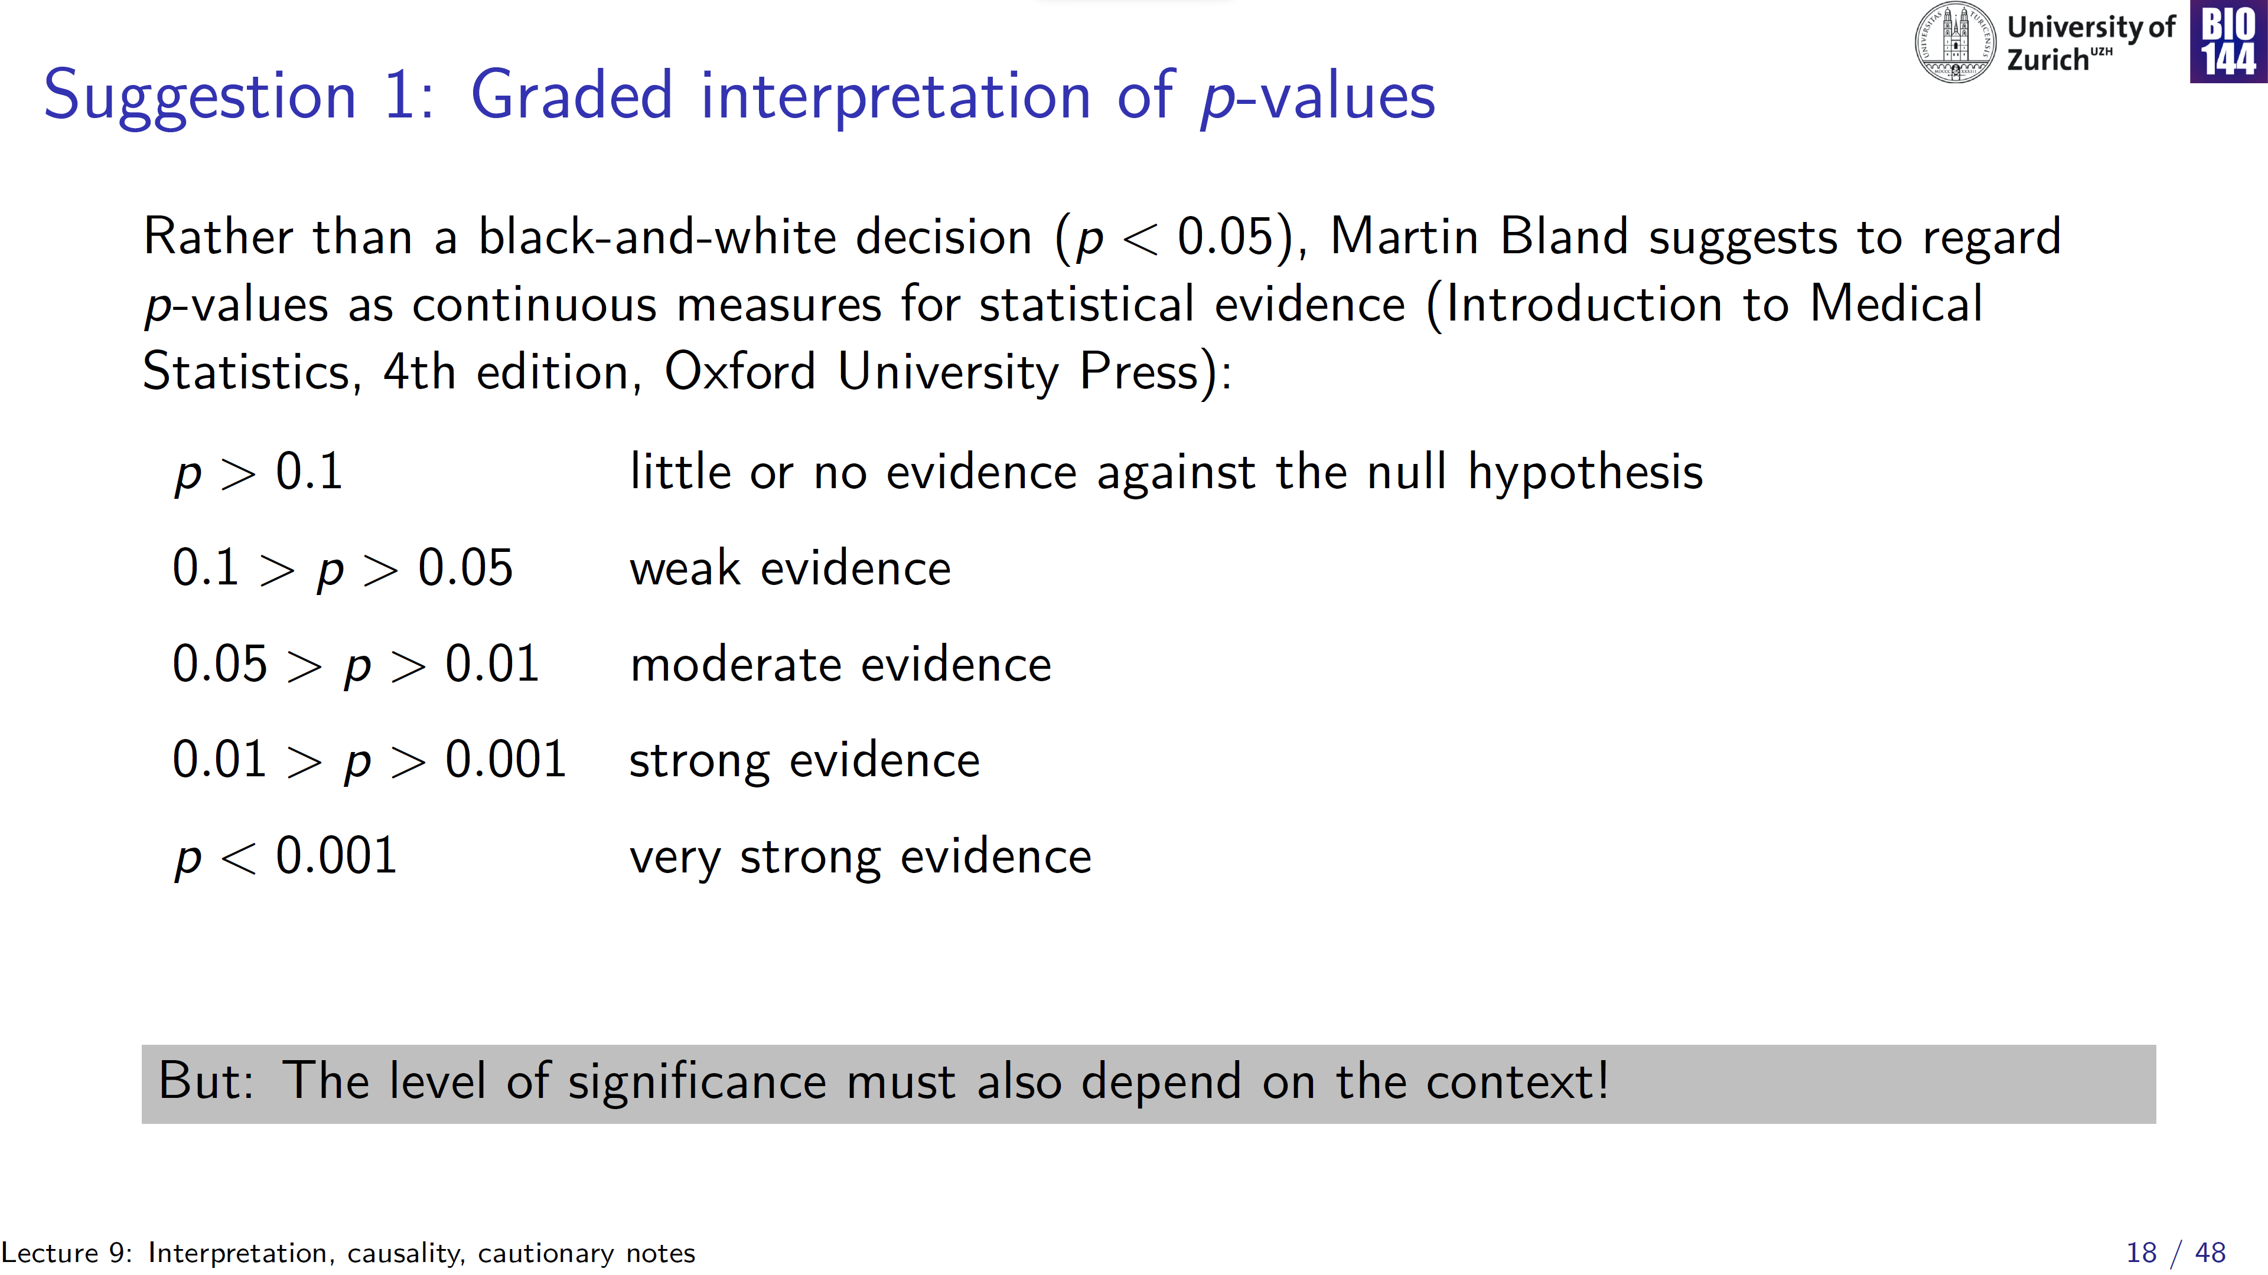

Slide 19
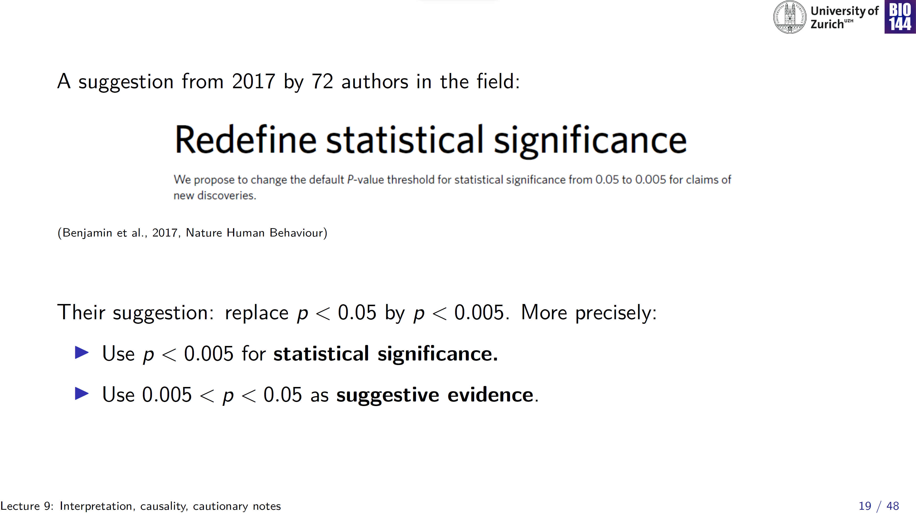
However, equally arbitrary!

Slide 20
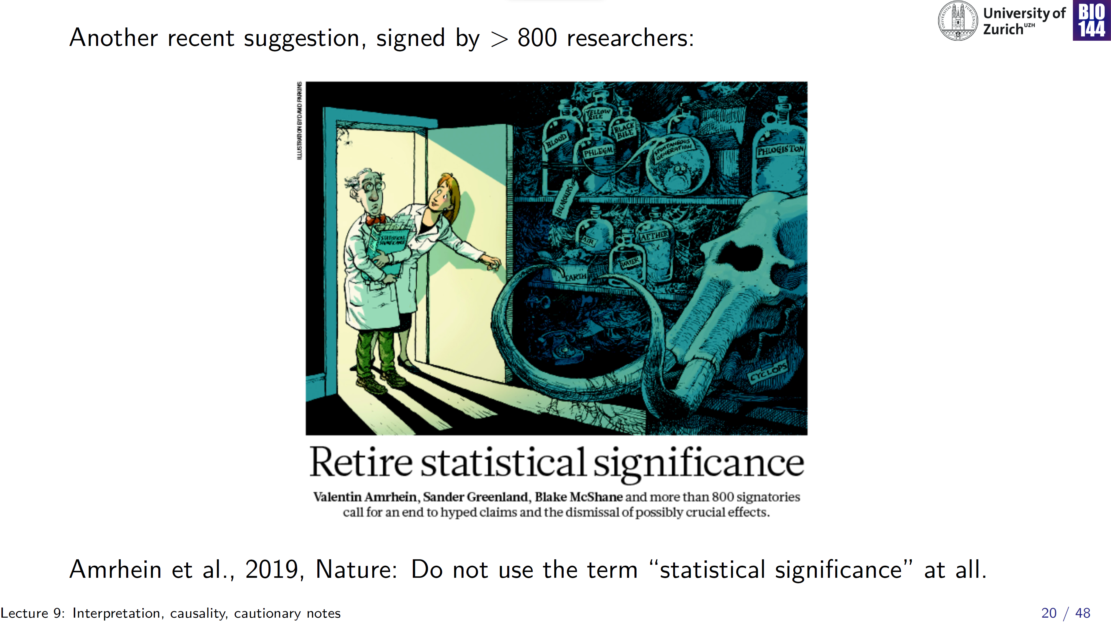

Slide 21
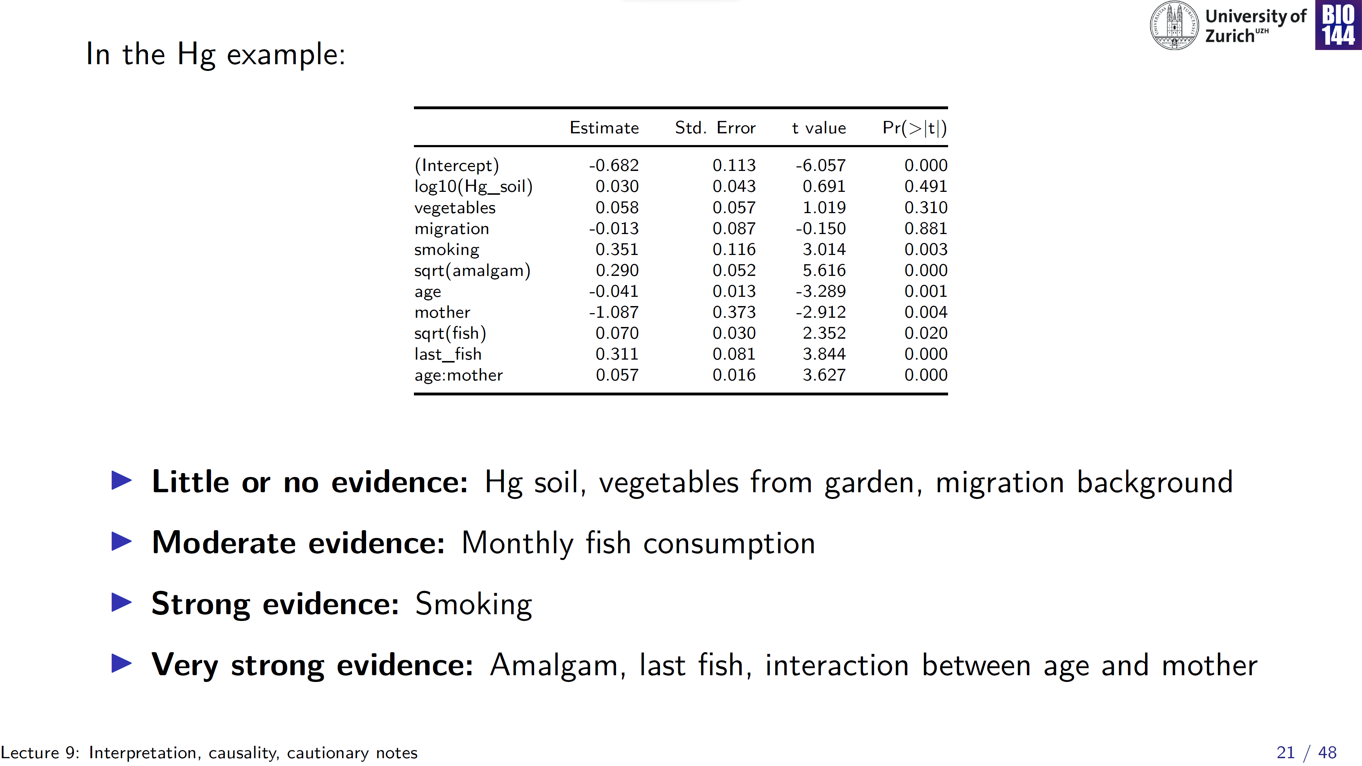
Notes:
Interpreting p as a continuous measure of relevance

Slide 22
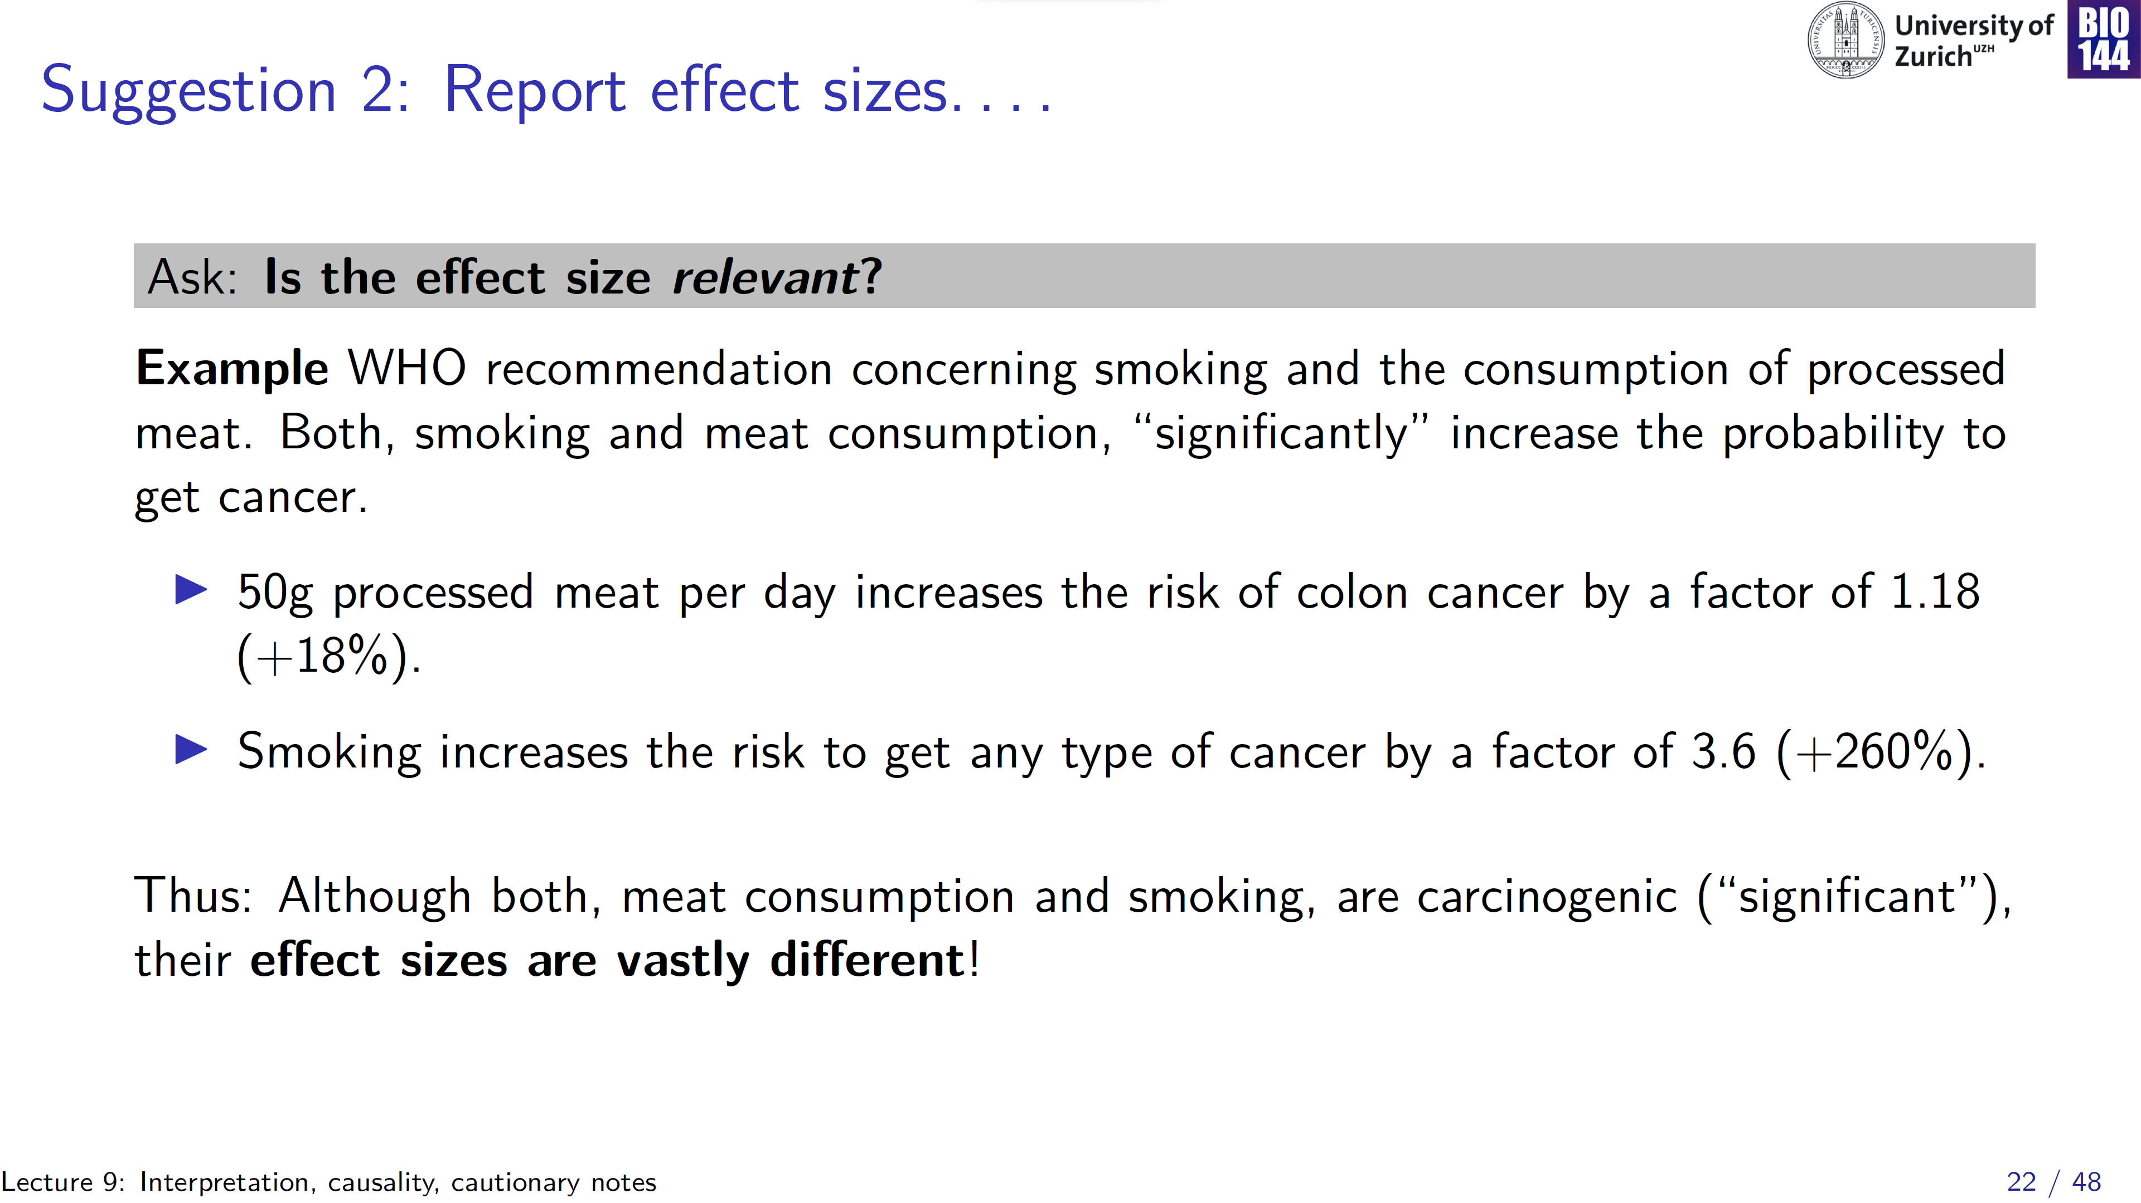
Notes:
Would need much more context here as well, to be able to more properly interpret these effect sizes: e.g. smoking 1 cigarette per day, smoking 5 vape pods per day?

Slide 23
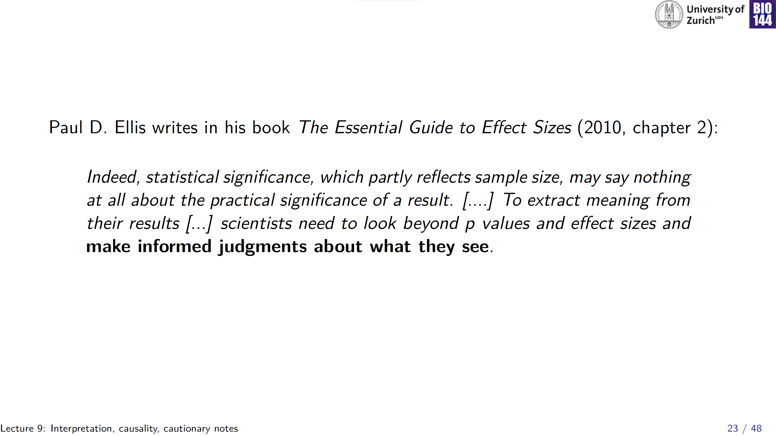
Notes:
P-values, effect sizes are tools, not excuses to not think critically about your findings

Slide 24
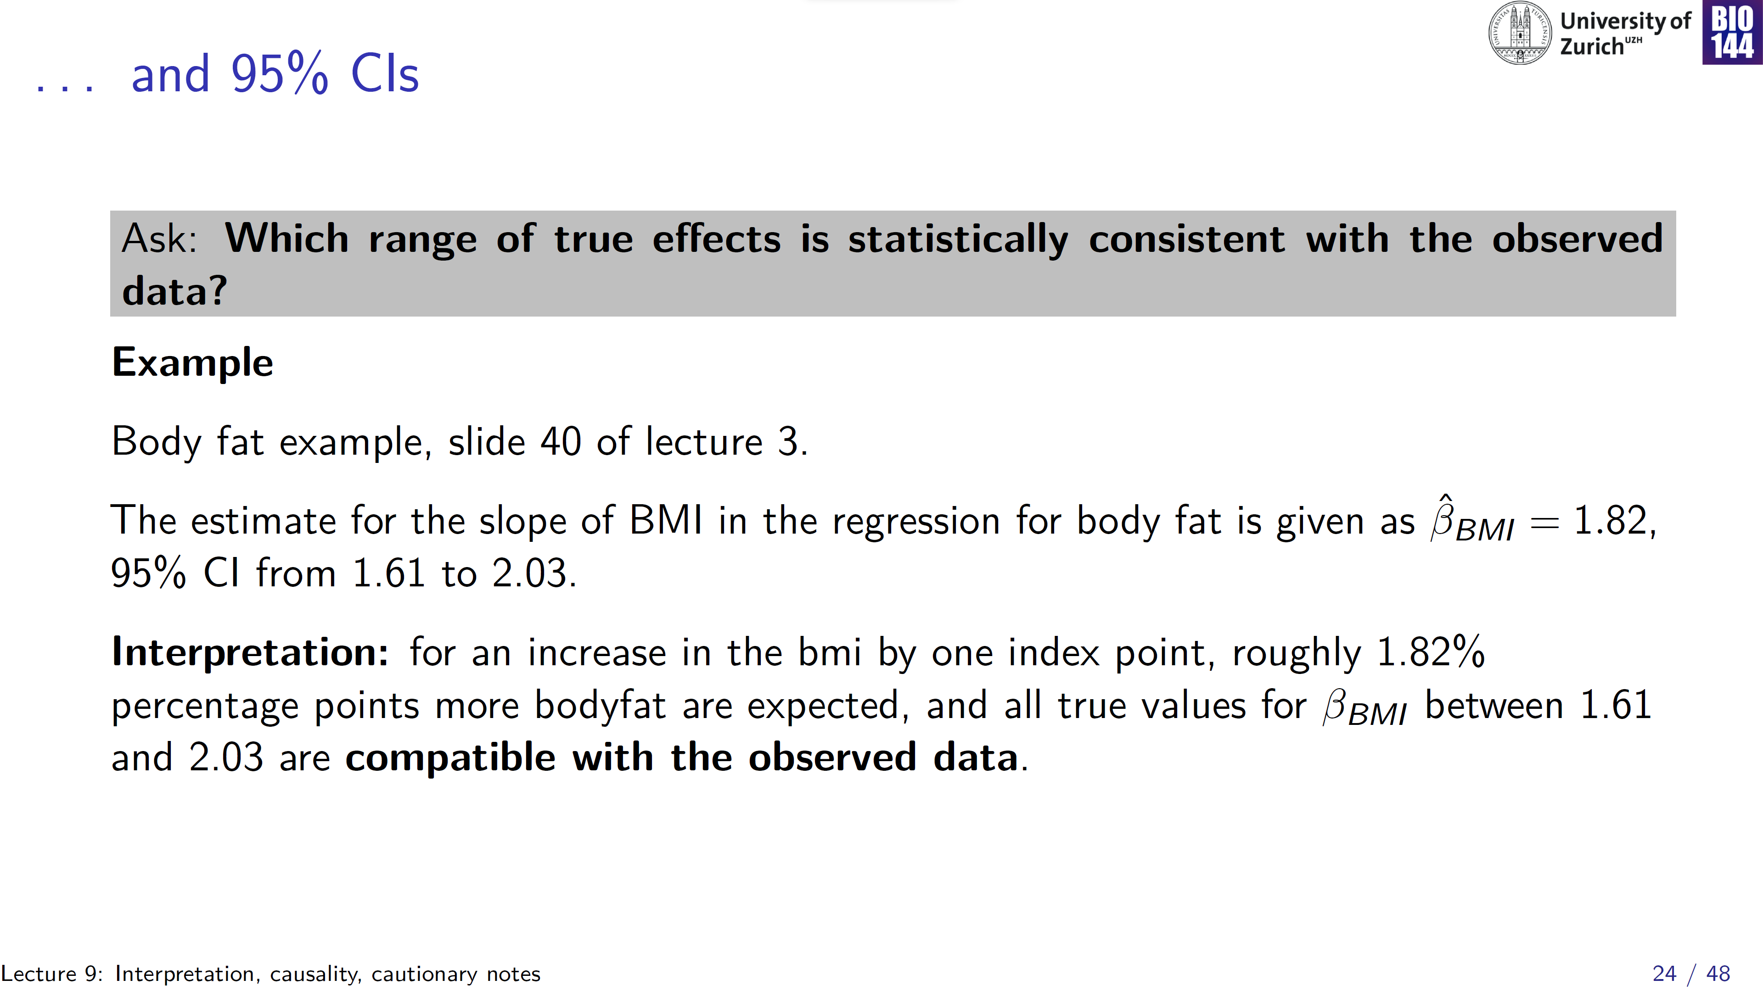
Notes:
Another tool that can help to critically interpret your results are confidence intervals

Slide 25
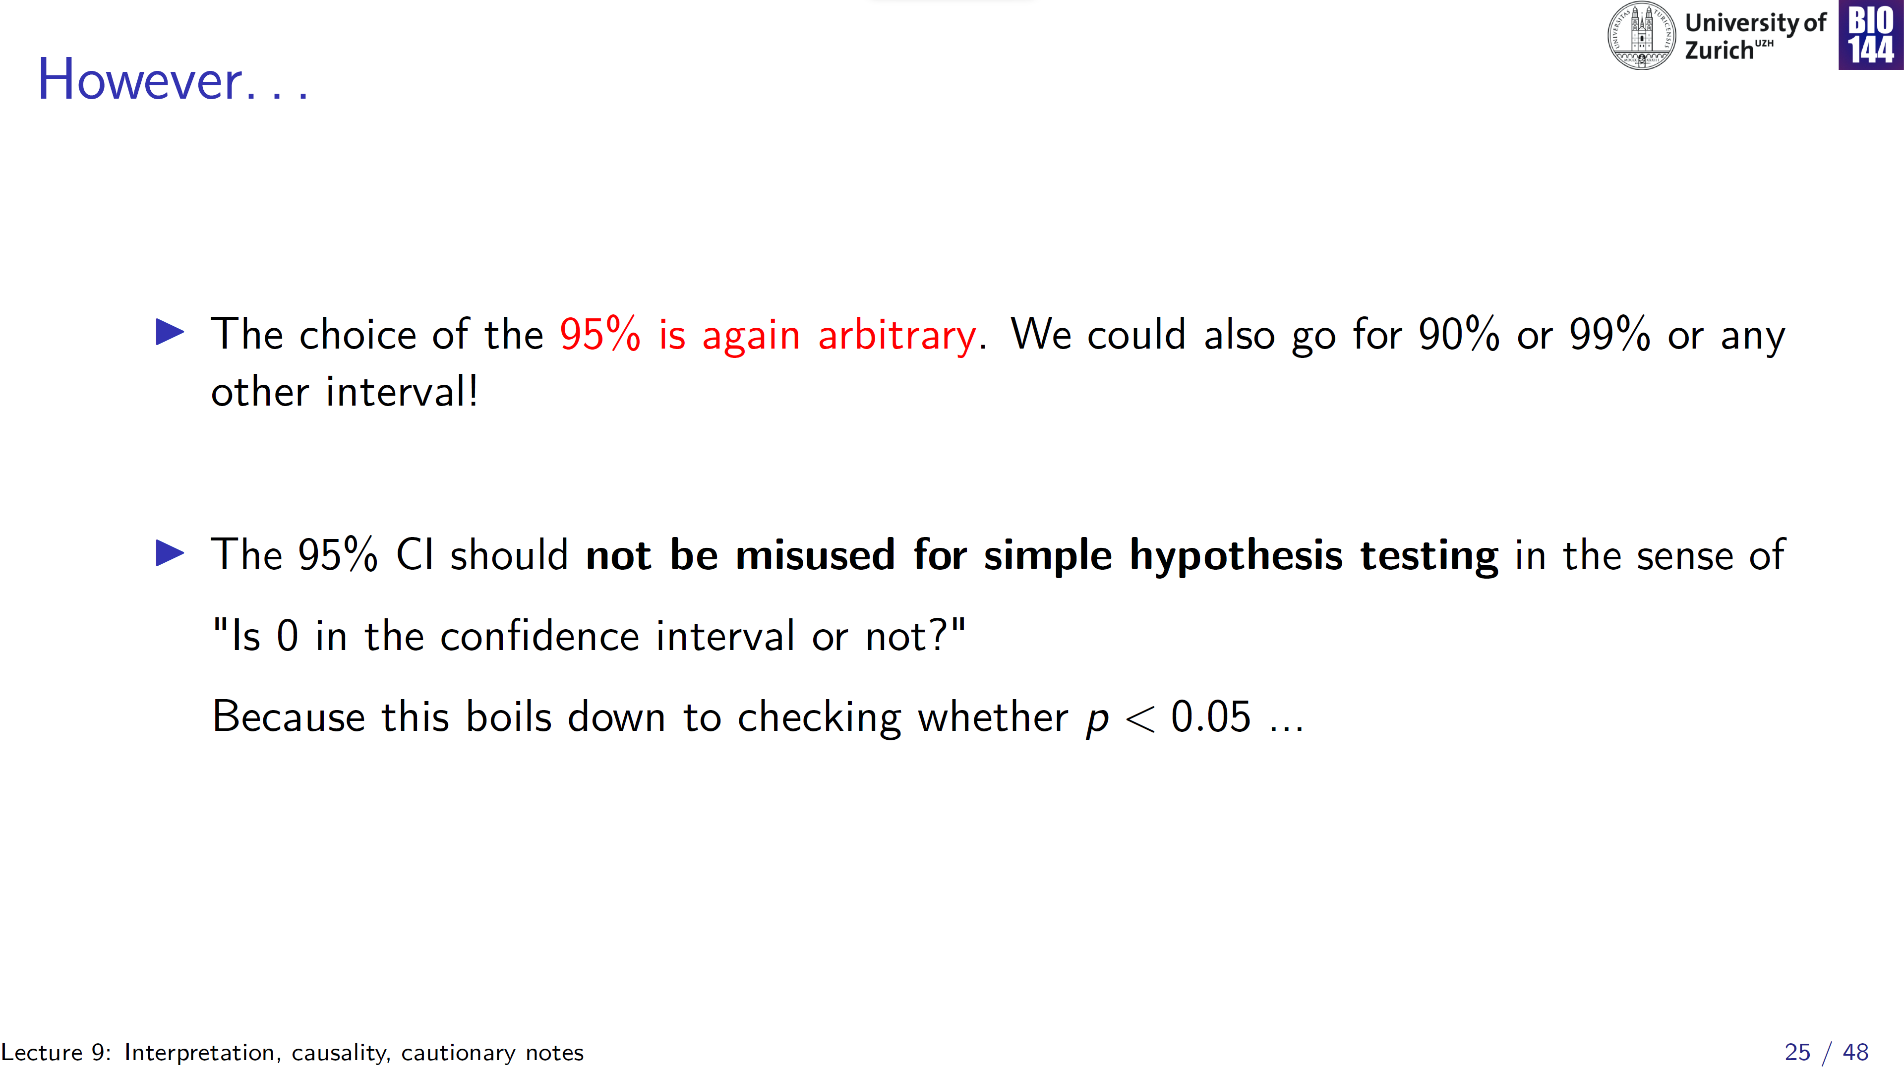
Notes:
It’s an indication of how confident you are about the magnitude of the effect you observed

Slide 26
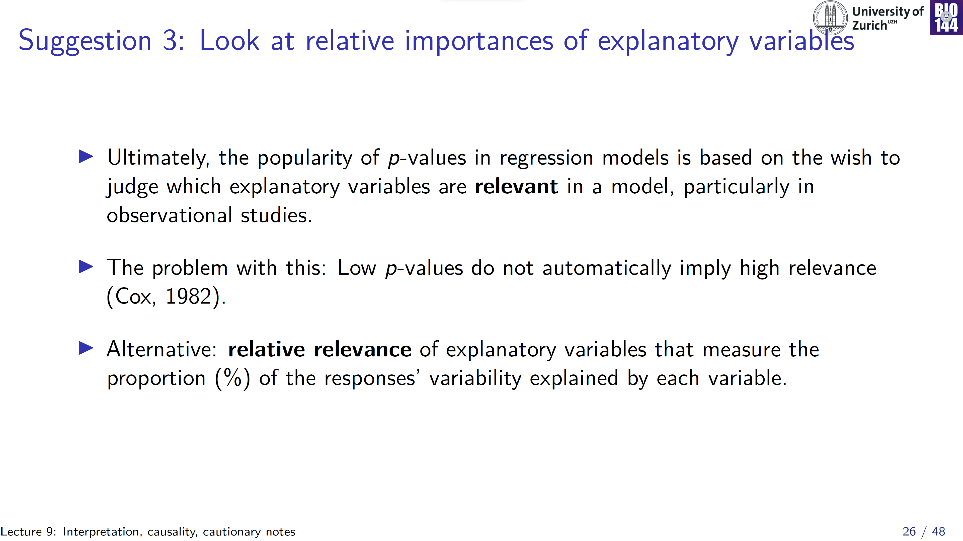
Notes:
If interpreting p-values in absolute terms is tricky, perhaps interpreting them in relative terms Can be informative…

Slide 27
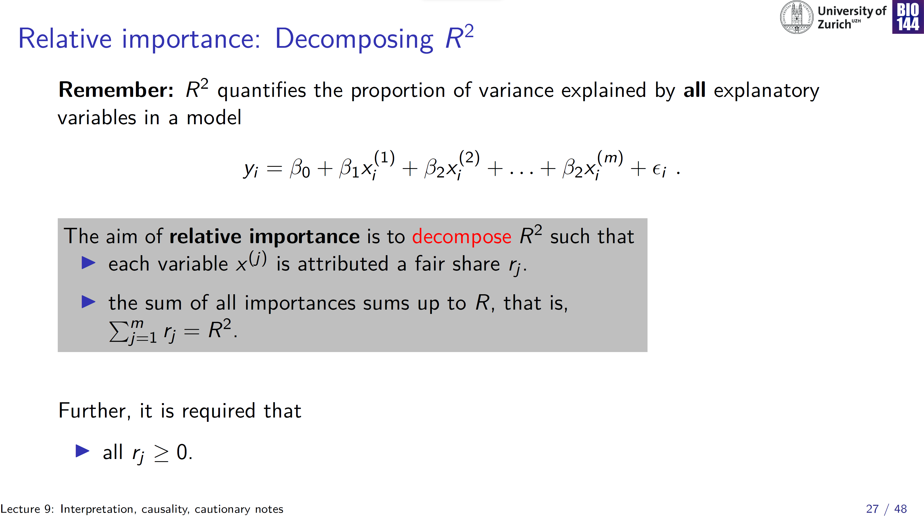

Slide 28
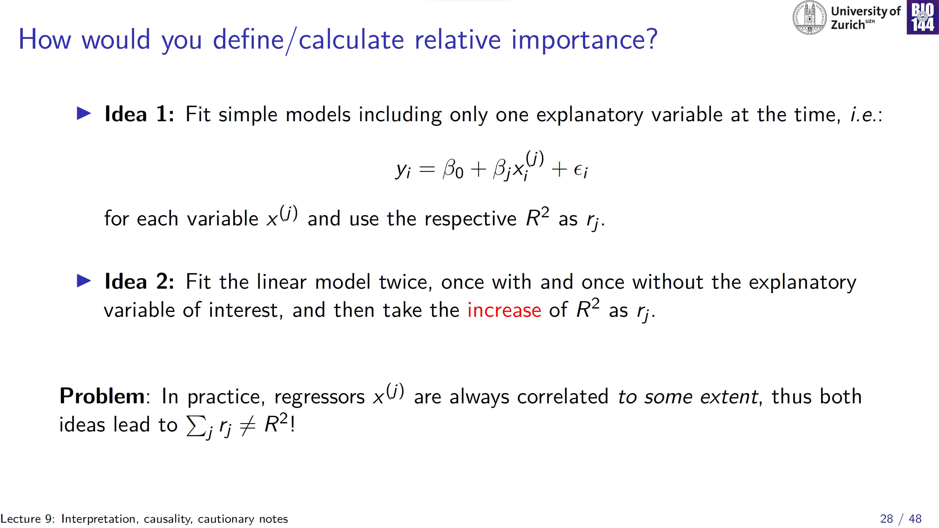
Total variability in y
Variability in y explained by x₁
Variability in y explained by x₂
Notes:
Dsitinction between unique and shared variability explained

Slide 29
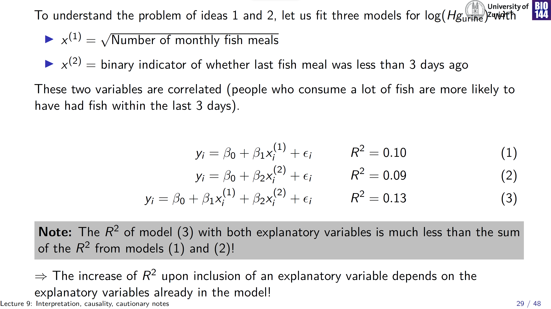

Slide 30
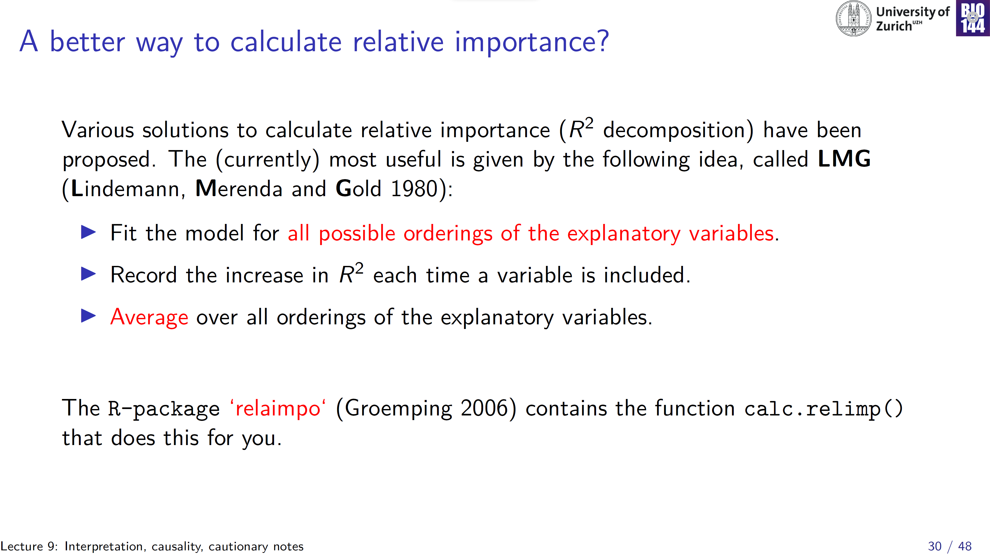
Notes:
BREAK

Slide 31
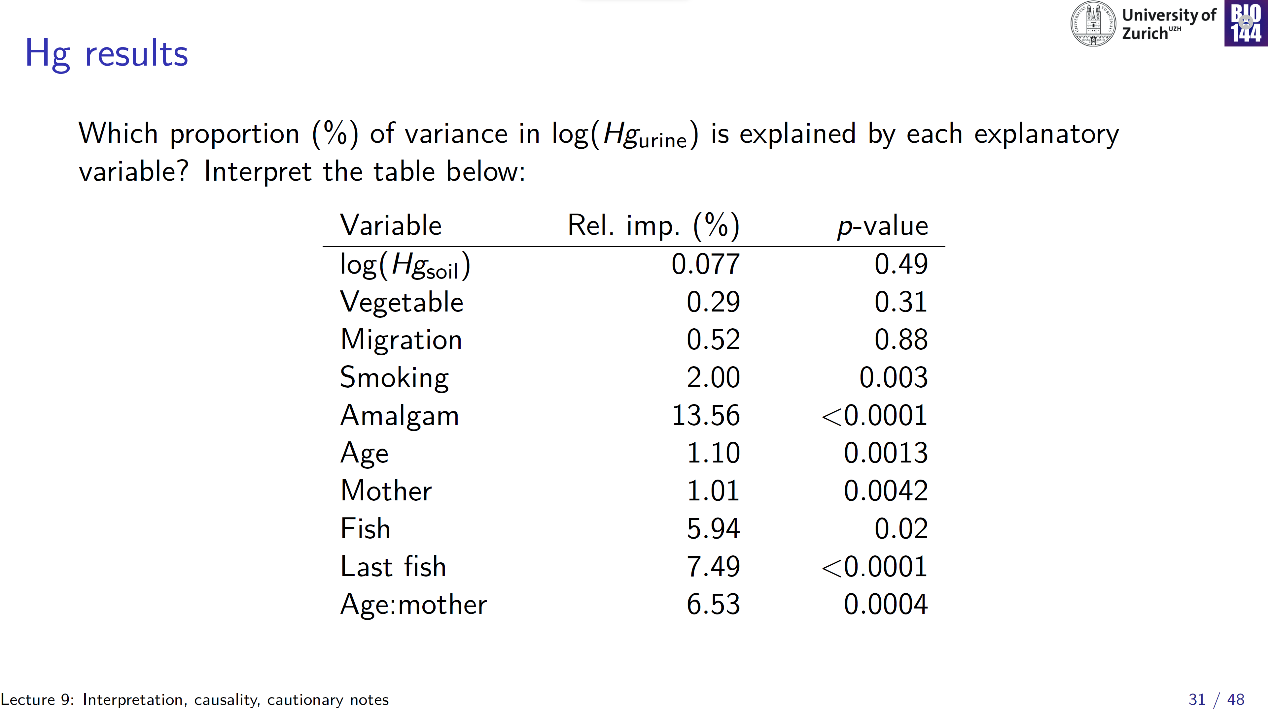
Similar p-value, yet different relative importance
Different p-value, yet similar relative importance
Notes:
Similar p-values, yet differences in relative explanatory importance: “last fish” and “amalgam”
Different p-values, yet similar relative explanatory importance

Slide 32
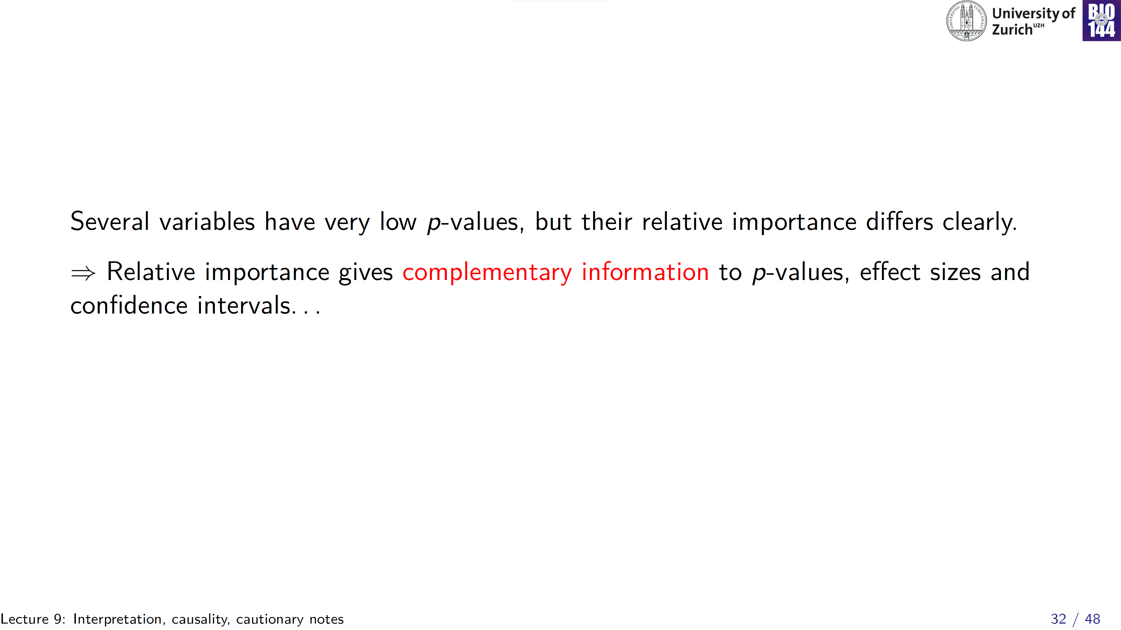

Slide 33
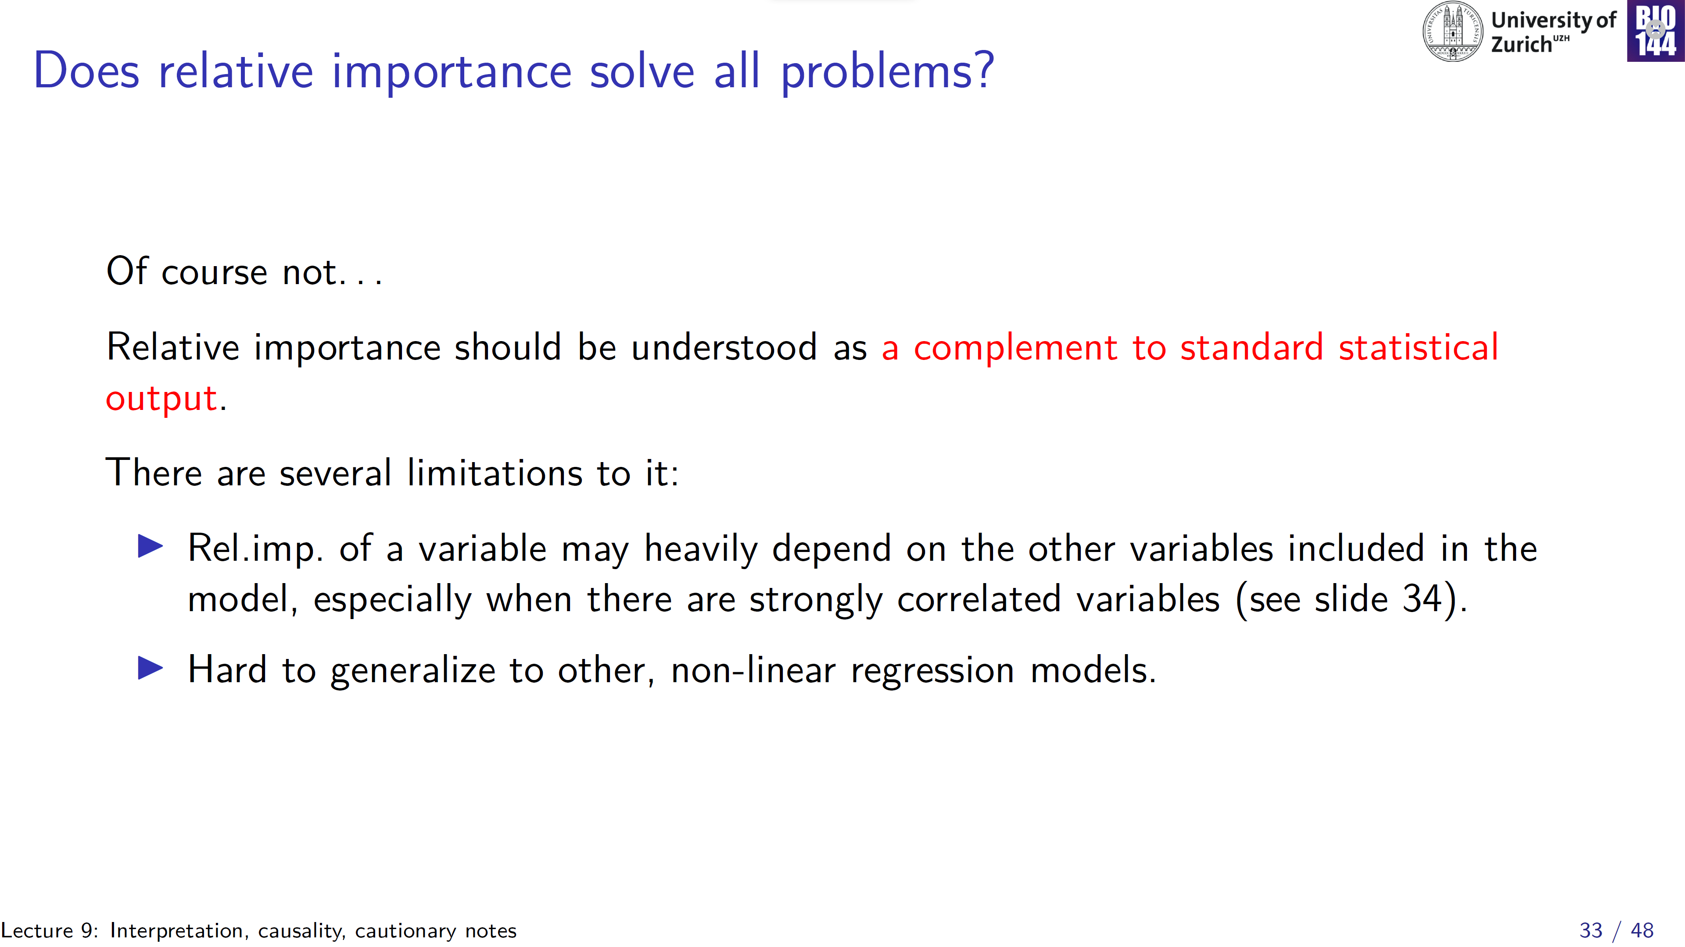

Slide 34
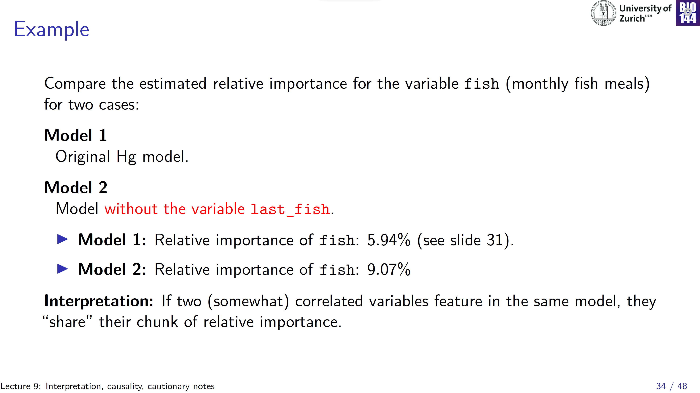

Slide 35
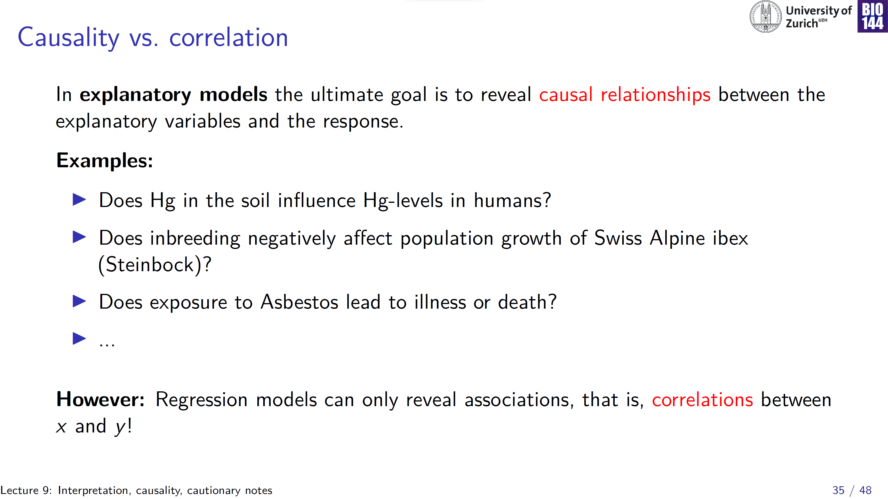
Notes:
Statistics can only reveal association

Slide 36
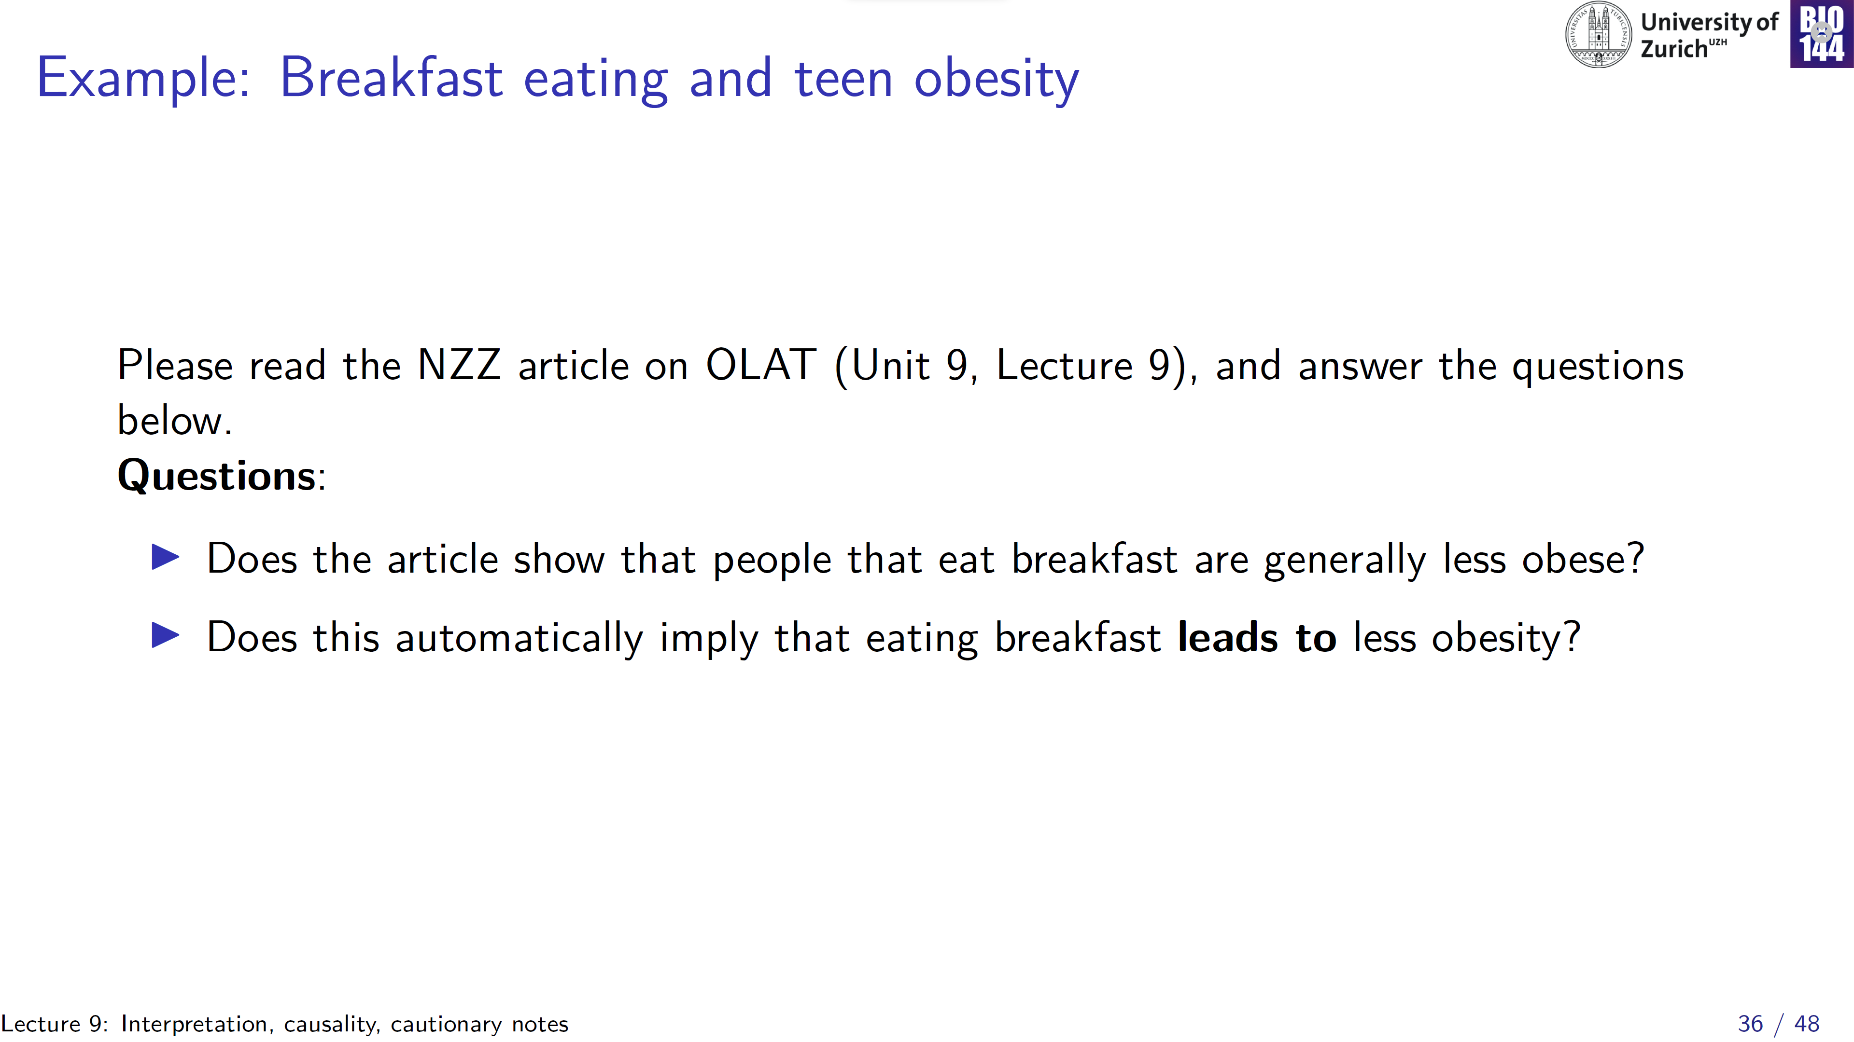

Slide 37
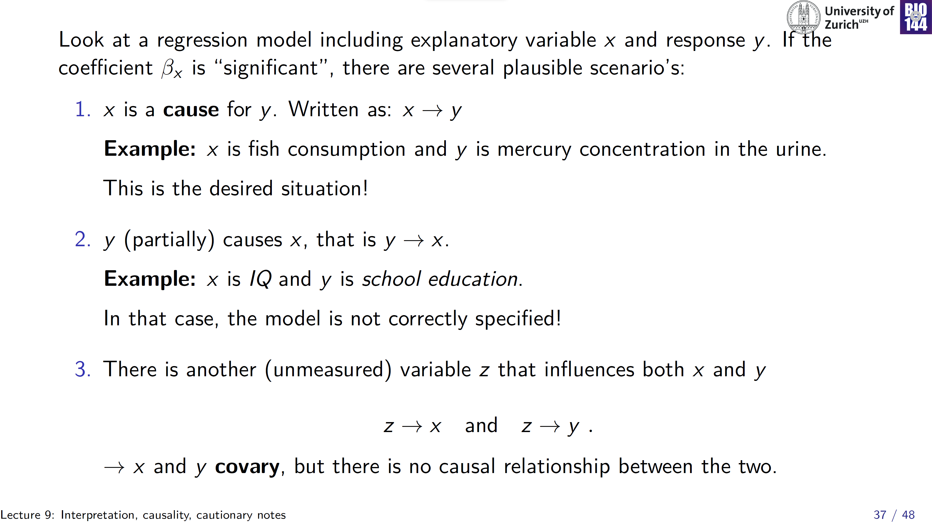

Slide 38
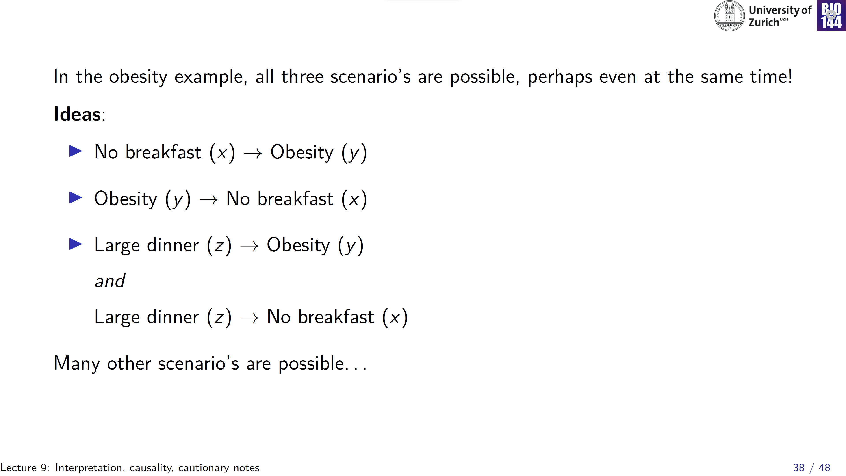

Slide 39
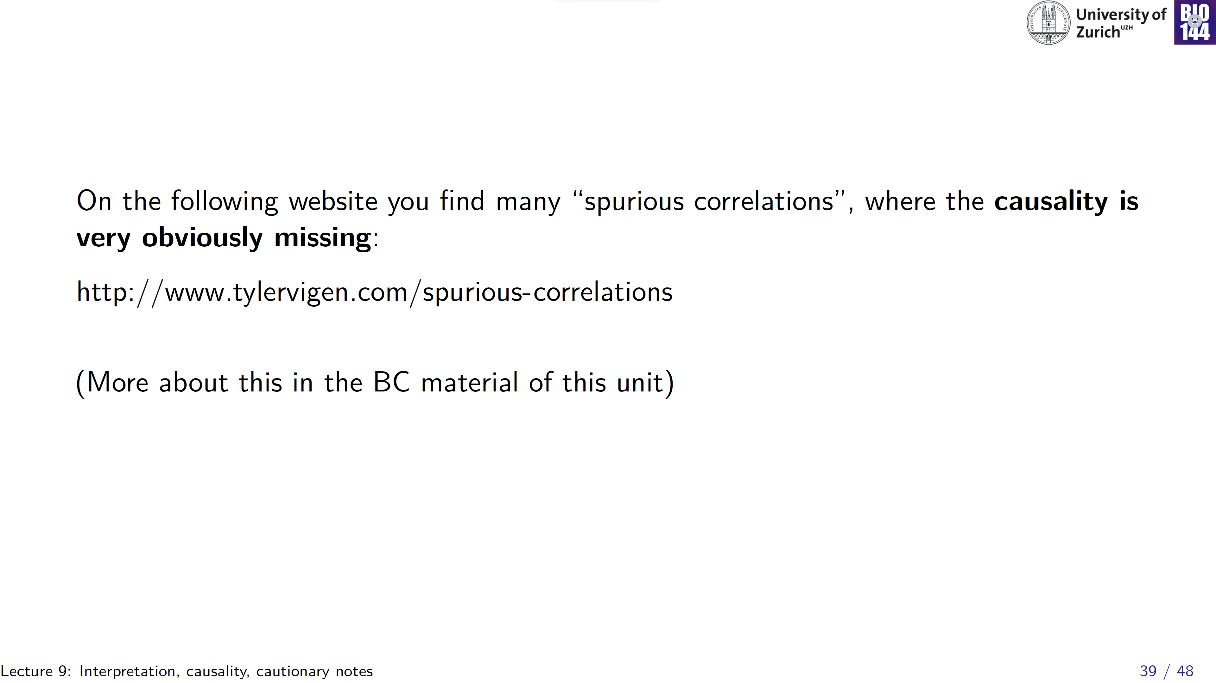

Slide 40
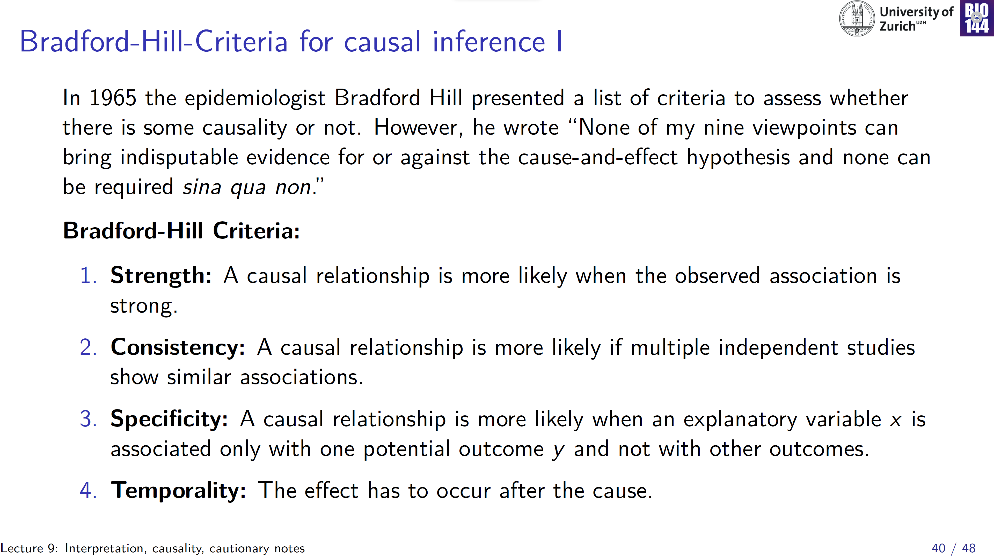
None of these are either necessary, or sufficient!
Still, useful considerations when interpreting your own results

Slide 41
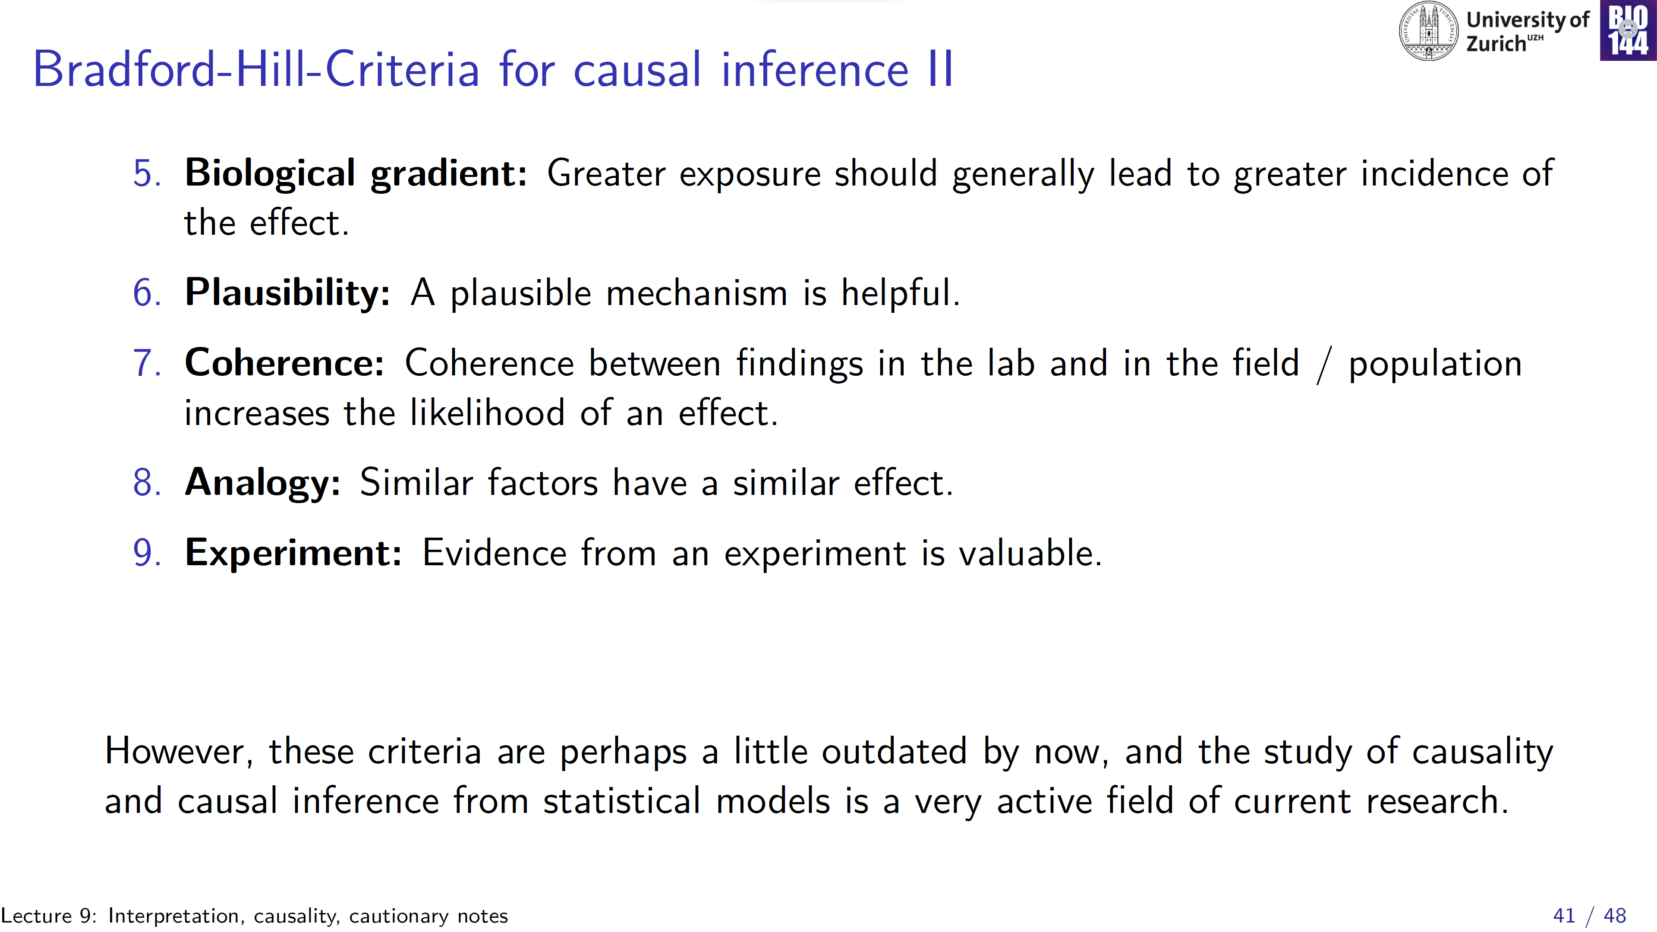
Notes:
Beyond the scope of an introductory stats course

Slide 42
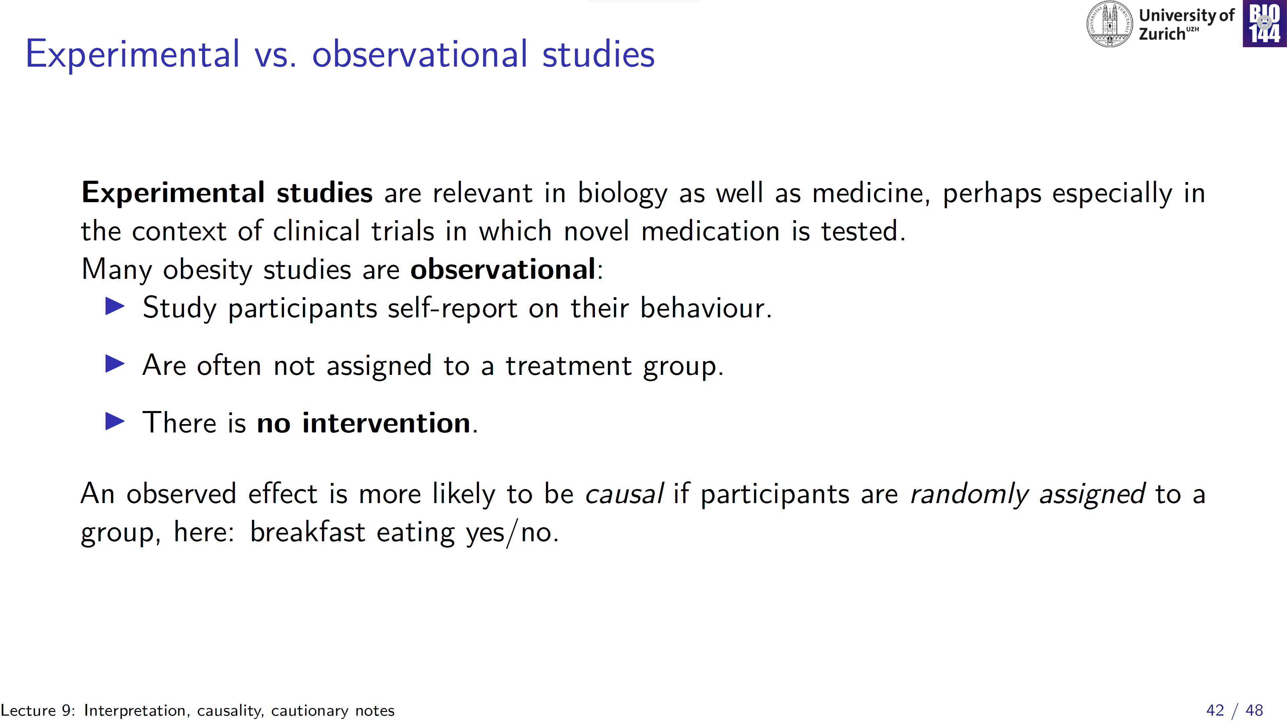
Randomized Controlled Trial (RCT):
Considered by many to be the golden standard with regard to causal inference

Slide 43
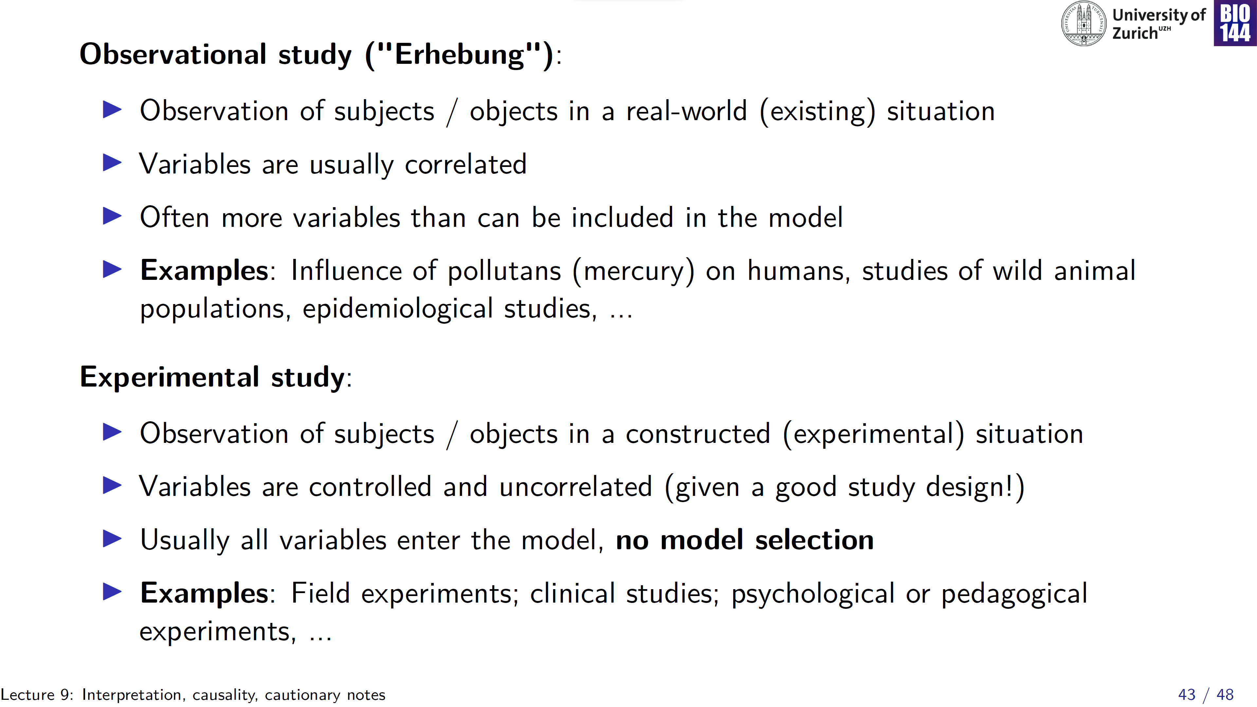

Slide 44
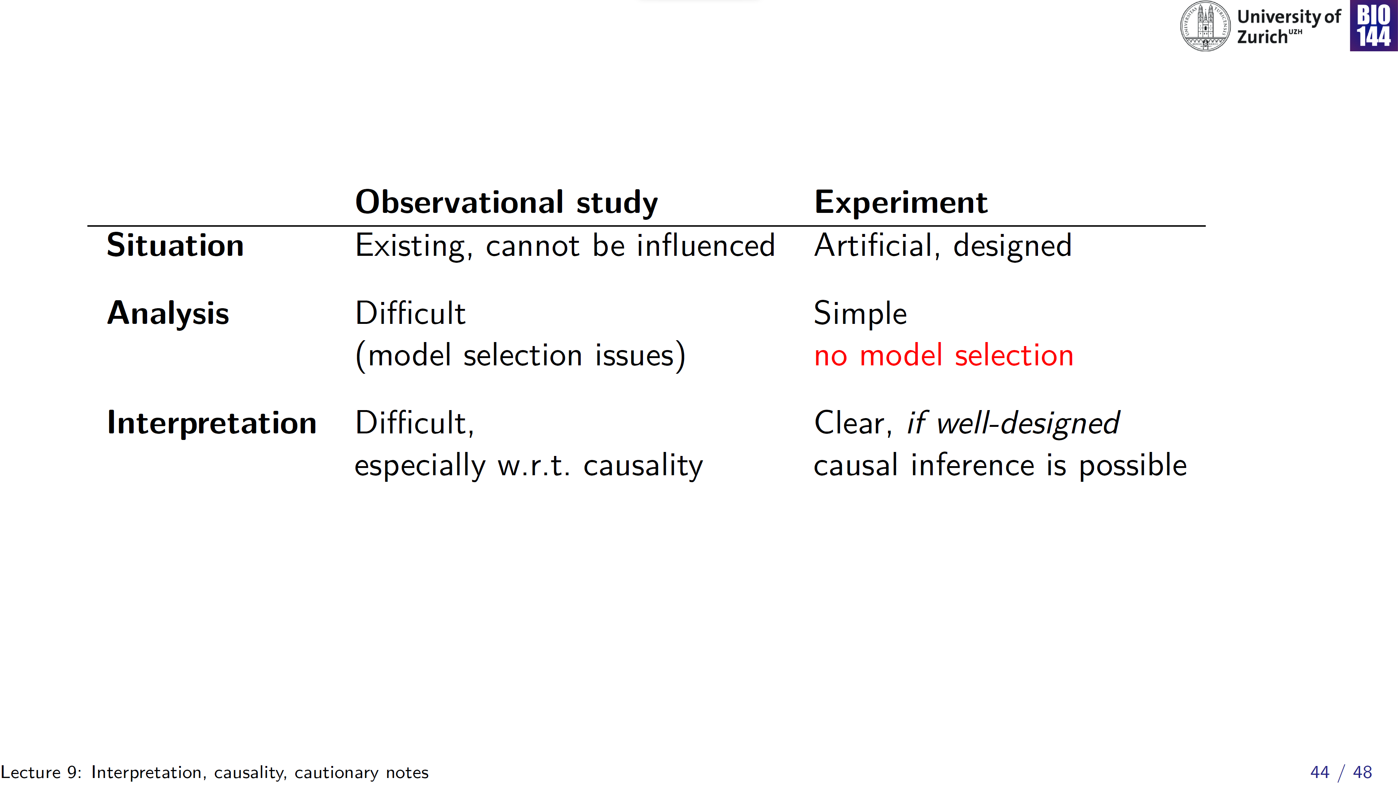

Slide 45
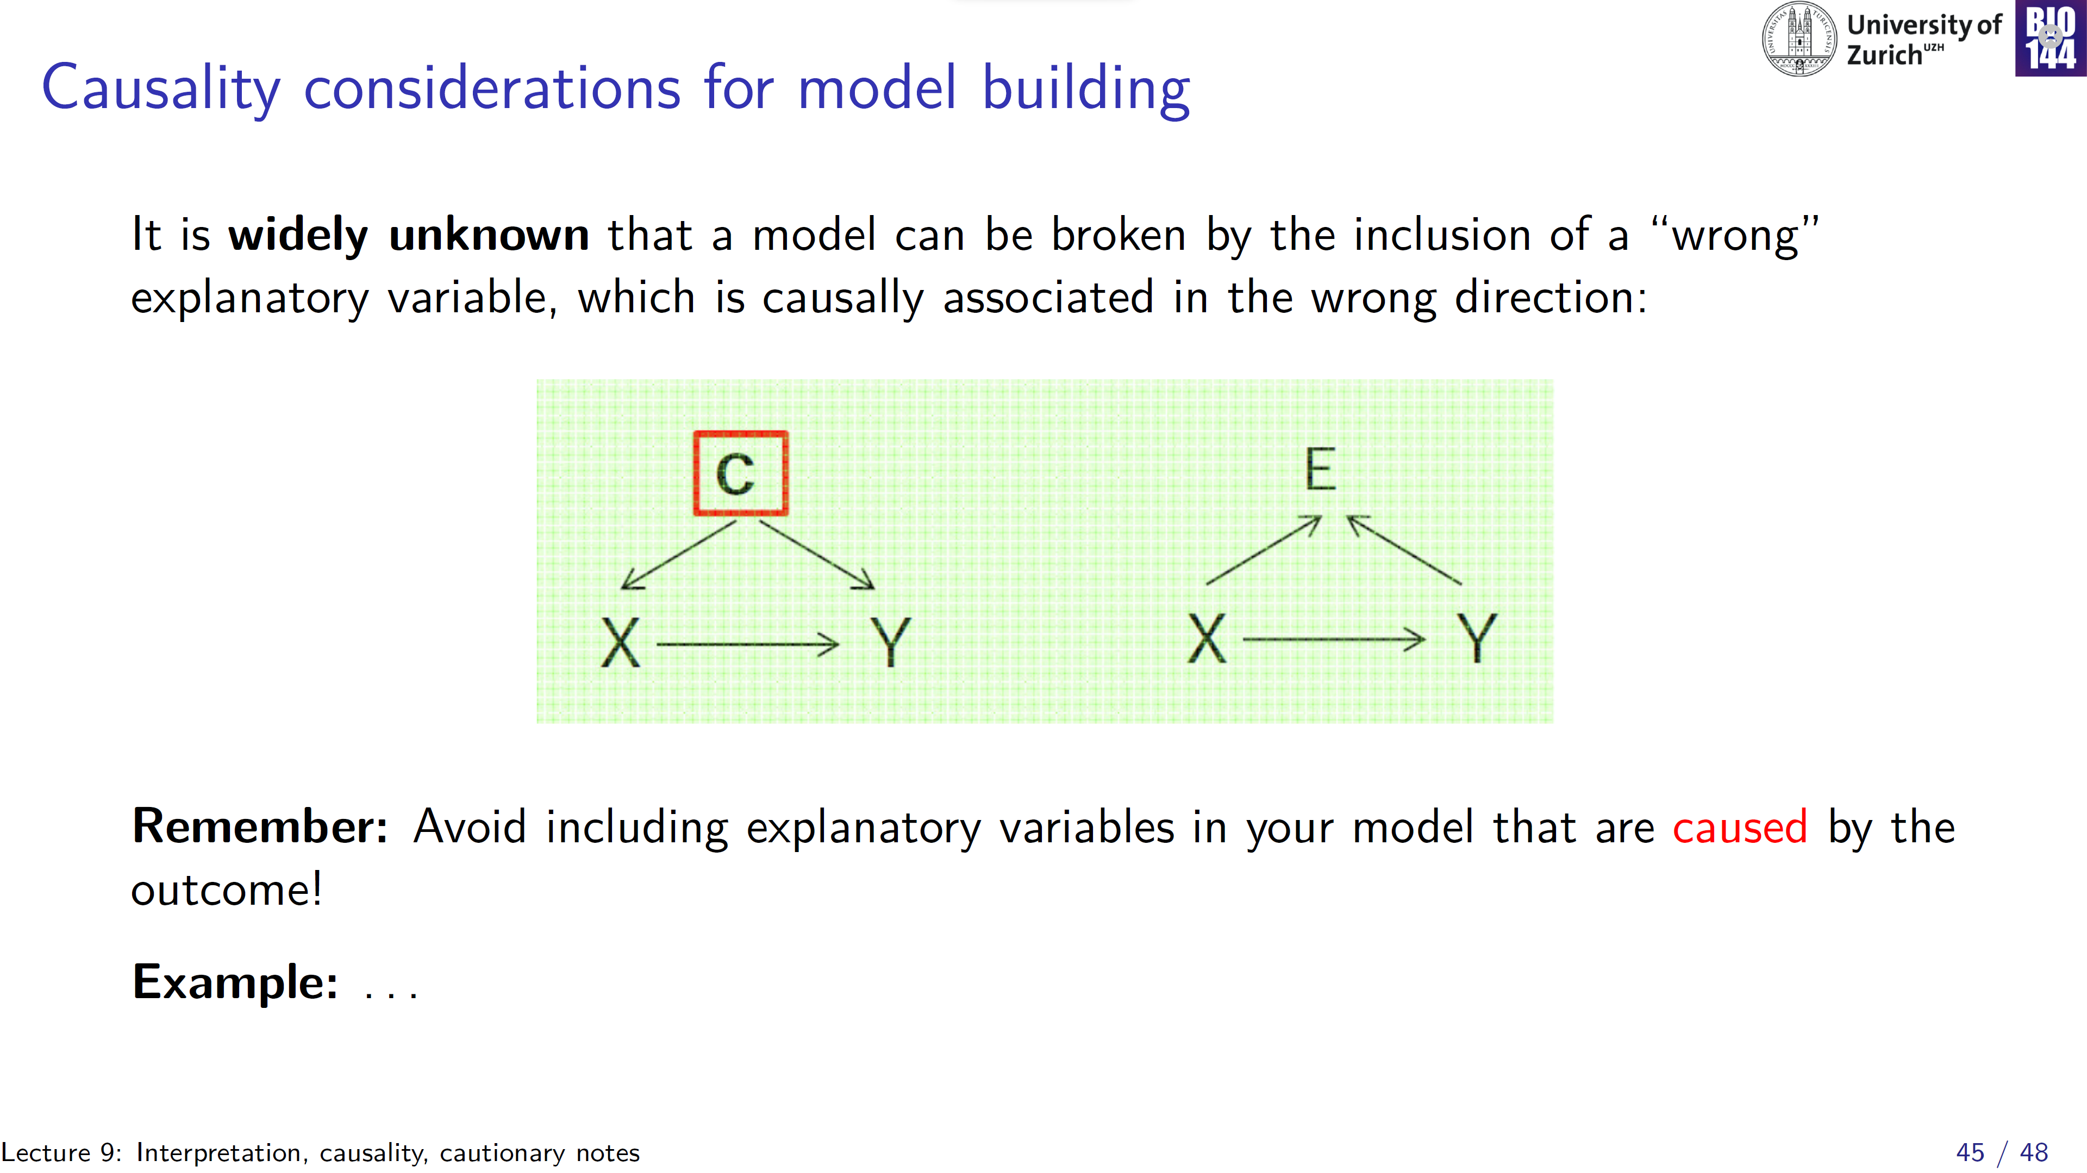
Directed Acyclic Graph (DAG):
schematic representation of the (assumed) causal structure among variables of interest
Common cause (a “fork”):
breaking the fork (including C in the model equation) removes any spurious association between X and Y
Common effect (a collider):
including E in the model equation, introduces a spurious association between X and Y

Slide 46
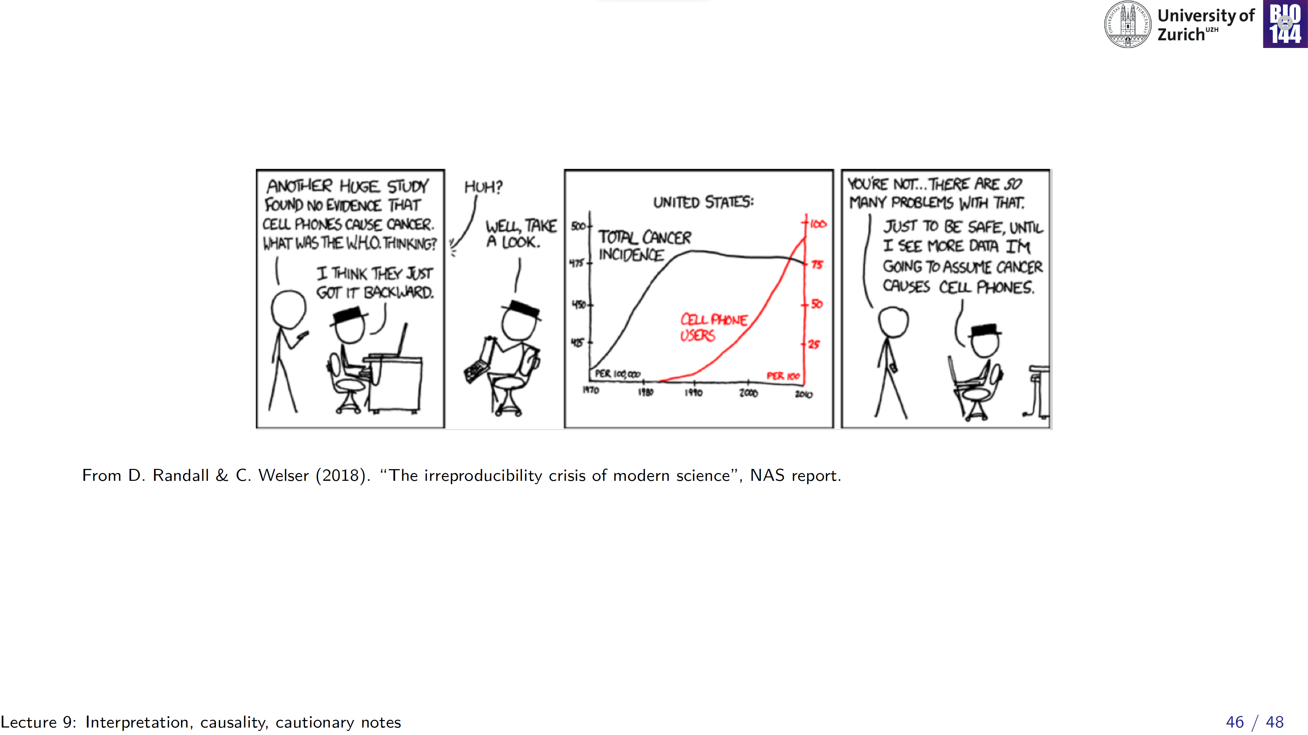

Slide 47
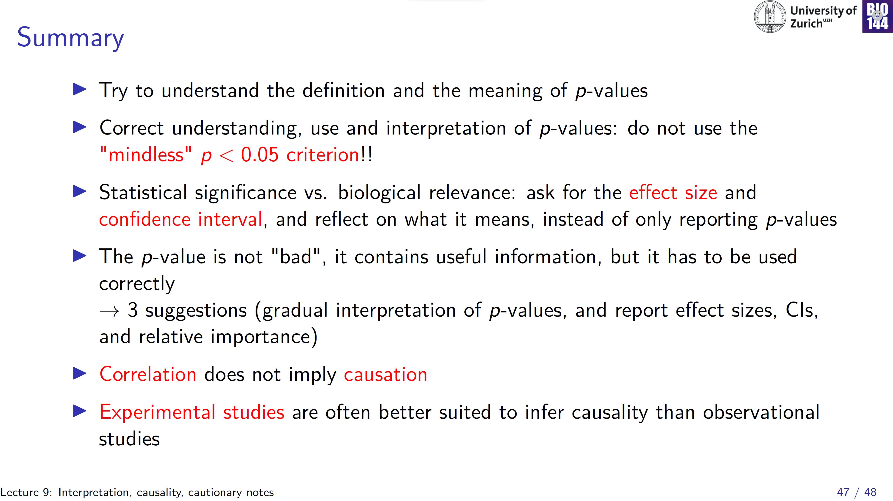

Slide 48
